Slide 1
You will NOT receive credit for the session if you:
Fail to work on your question sheet;
Place your head on the desk/sleep;
Socialize/Visit/Talk with others during the session;
Arrive late and/or leave early;
Have your cell phone out.

Slide 2
After-School Review Session #11
Presidents Johnson and Nixon,
The War on Poverty, and
The Vietnam Conflict

Slide 3
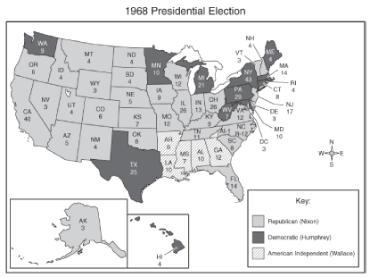
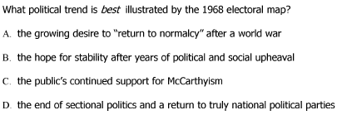

Slide 4
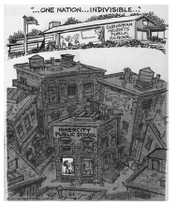
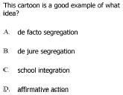
Name of school: “Suburban Heights Public School”

Slide 5
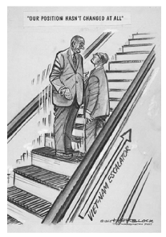
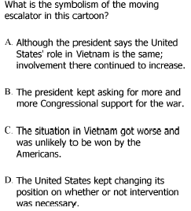
Who is the man on the left in the cartoon?
What policy does this cartoon represent?

Slide 6
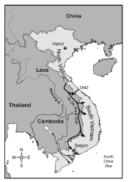
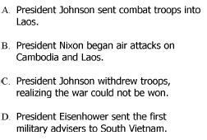
What is the line that separates N. and S. Vietnam?
What is the arrow pointing to?
What change in the Vietnam Conflict resulted from the supply line shown on the map?

Slide 7
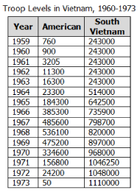
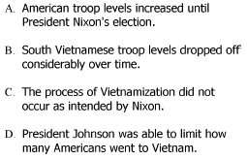
What conclusion can be drawn from the information on this chart/graph?

Slide 8
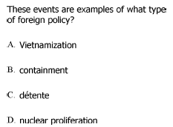

Slide 9
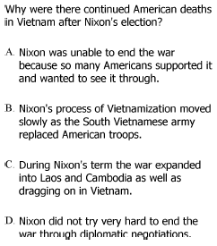
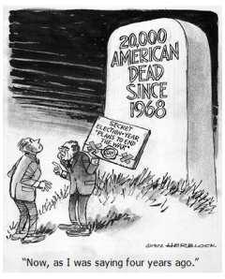

Slide 10
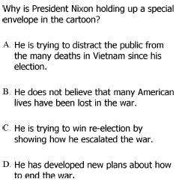

Slide 11
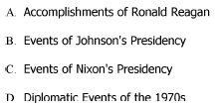
What is the best heading for this outline?

Slide 12
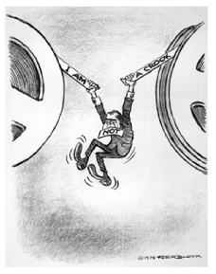

Slide 13
