Slide 1
You will NOT receive credit for the session if you:
Fail to work on your question sheet;
Place your head on the desk/sleep;
Socialize/Visit/Talk with others during the session;
Arrive late and/or leave early;
Have your cell phone out.

Slide 2
America Steps Up: Imperialism
After-School Review Session #5

Slide 3
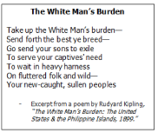
What cause of imperialism is written about below? What are some other causes? Which cause was the most important factor fueling American imperialism?

Slide 4
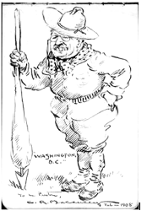
Which term best describes the concept the artist was expressing in this illustration? A. Dollar Diplomacy B. Moral Diplomacy C. Open Door Policy D. Big Stick Policy
Who is the man pictured at left?

Slide 5
“Whether they will or no, Americans must now begin to look outward. The growing production of the country demands it. An increasing volume of the public sentiment demands it…”
Alfred T. Mahan
What reason does Mahan give for engaging in imperialism?
What did he propose that the government do in order to engage in imperialism?

Slide 6
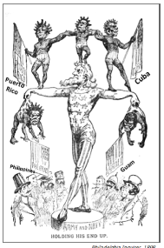
Based on the artist’s portrayal of the various countries, which idea is supported by this cartoon? A. A belief in Social Darwinism B. Support for nativism C. The concept of assimilation D. The idea of the American melting pot
Army and Navy
“Holding his end up.”

Slide 7
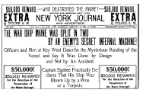
This is an example of…
What did it lead to and how?
What were the other causes of the Spanish-American War?

Slide 8
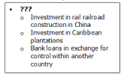
What would be the best title for this section of notes from an American History class?
Open Door Policy
Dollar Diplomacy
Roosevelt Corollary
Monroe Doctrine

Slide 9
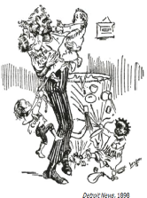
With which statement would the artist of this political cartoon most likely agree?
The United States should be the policeman of the world
The United States is not ready to be an imperial power.
The United States should acquire more territory.
The United States needs to focus on building a better military.

Slide 10
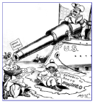
In this cartoon, why is Teddy Roosevelt pointing a cannon at the king?
“Monroe Doctrine”
To ensure that the United States stays isolated
To declare war against European nations
To prevent American ships from being attacked
To threaten Europe to stay out of the Western Hemisphere
Europe

