Slide 1
You will NOT receive credit for the session if you:
Fail to work on your question sheet;
Place your head on the desk/sleep;
Socialize/Visit/Talk with others during the session;
Arrive late and/or leave early;
Have your cell phone out.

Slide 2
The Roaring 20s aka The Jazz Age aka The 1920s
After-School Review Session #6

Slide 3
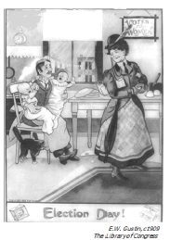
What objection to granting suffrage rights to women is most evident in this cartoon?
Women do not have enough education to make an informed decision
Women will vote for the same candidate as their husbands
Giving voting rights to women will force women to work outside the home
Allowing women to vote will break down traditional gender roles

Slide 4
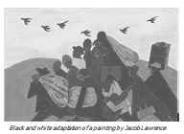
This painting by Jacob Lawrence is best associated with which idea?
The impact of desegregation efforts in rural areas
The effects of the Great Migration on African Americans
The impact of WWI on industrial workers in rural areas
The impact of the Great Depression on migrant workers

Slide 5
The quote below deals with an action from the early-1900s that many sought to enforce during the 1920s.
“According to those who supported the measure, it was a noble experiment. But it proved impossible to enforce and consequently increased disrespect for the law.”
The “noble experiment” described in the passage above was
the integration of public schools
the passage of child labor laws
the prohibition of alcoholic beverages
the extension of suffrage to women

Slide 6
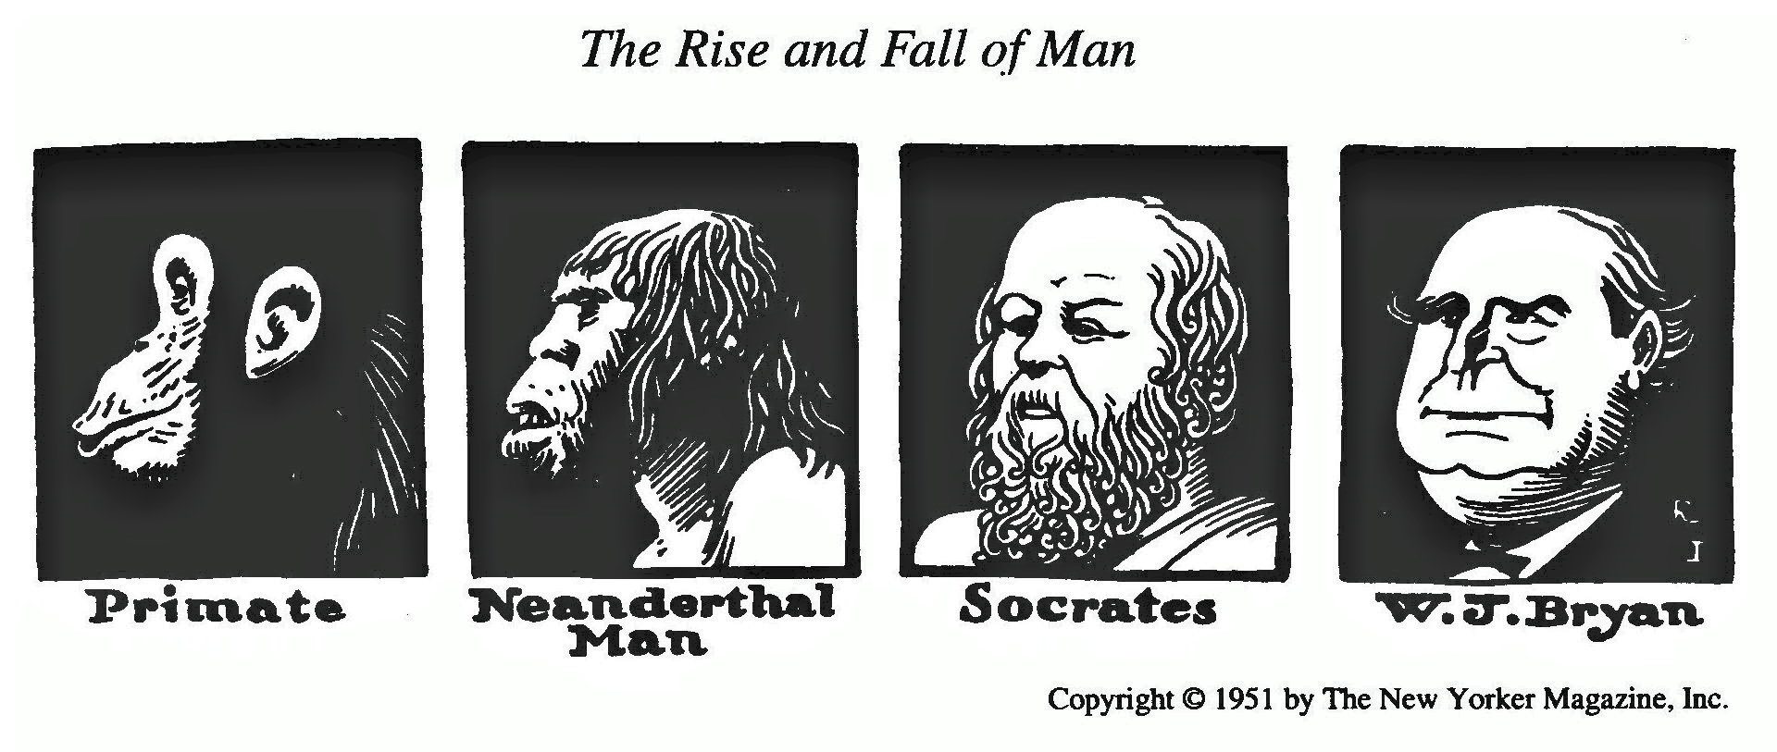
The cartoon above was intended primarily as a humorous comment on
Social Darwinism
the Scopes trial
the Red Scare
the Plessy decision

Slide 7
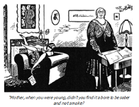
Whose viewpoint is best symbolized in this cartoon?
“Mother, when you were young, didn’t you find it a bore to be sober and not smoke?”
The female suffragettes
The flapper generation
The religious fundamentalists
The muckraking journalists

Slide 8
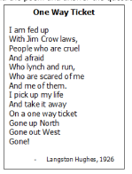
To what event is Langston Hughes referring in this poem?
The Great Migration
The Flapper Movement
The Scopes Trial
The Red Scare

Slide 9
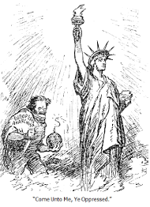
What kind of fears are reflected in this cartoon?
Communist fears of the free market
Fears of international terrorism
Fears of presidential scandals
Nativist fears of immigrants
Come unto me, ye oppressed.

Slide 10
“… Our whole system of self-government will crumble either if officials elect what laws they will enforce or citizens elect what laws they will support. The worst evil of disregard for some law is that it destroys respect for all law.…” — President Herbert Hoover, 1929
Which issue is President Hoover discussing in
this statement?
national Prohibition
environmental conservation
Social Security taxes
voting rights for women

