Slide 1
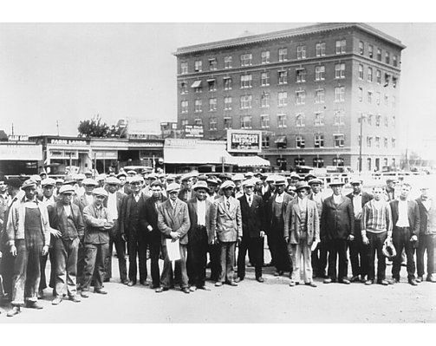
You will NOT receive credit for the session if you:
Fail to work on your question sheet;
Place your head on the desk/sleep;
Socialize/Visit/Talk with others during the session;
Arrive late and/or leave early;
Have your cell phone out.

Slide 2
After-School Review #7:
The Great Depression
A Time of Poverty and Despair
Notes:
Add a picture

Slide 3
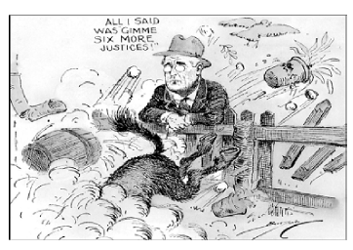
What did President Franklin Roosevelt do that caused the controversy illustrated in this cartoon?
He increased military spending
He created a plan to assume some powers reserved to the states
He tried to counter the Dust Bowl with conservation measures
He made proposals that violated the principle of separation of powers

Slide 4
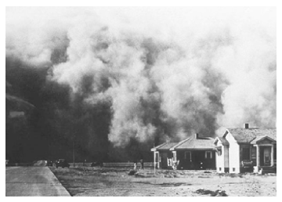
The Works Progress Administration and Social Security
The Resettlement Administration and Soil Conservation Act
The Tennessee Valley Authority and Works Progress Administration
The Job Corps and Department of Housing and Urban Development
What New Deal programs were put into place to address the problems depicted in this photograph?

Slide 5
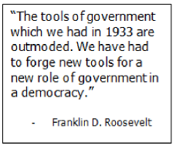
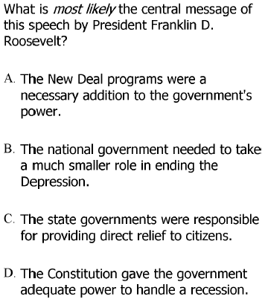
What was the “new tool” that FDR used to make the New Deal programs a reality?
Deficit Spending

Slide 6
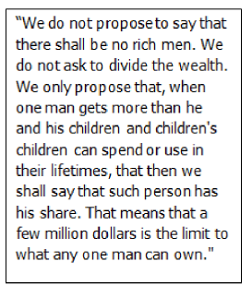
Did it work?
Why/Why not?
Which individual’s viewpoints are best represented in this quote about the New Deal?
Father Charles Coughlin
Herbert Hoover
Franklin D. Roosevelt
Senator Huey Long
Why would he offer this competing plan?
What was it called?

Slide 7
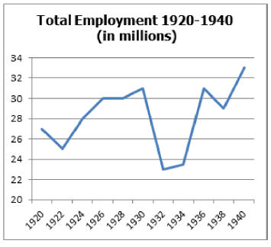
What trend(s) do you see on the graph?
What accounts for this trend/these trends?
What caused the decrease in 1936-37?
What caused the increase in 1938-39?
If the graph were to continue, do you see employment increasing or decreasing? Why?

Slide 8
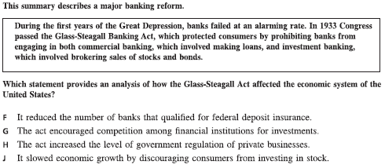

Slide 9
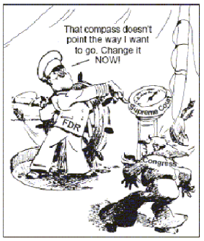
What does this cartoon illustrate?
Roosevelt’s dependency on Congress to get all of his legislative goals accomplished
Roosevelt’s frustration with the Supreme Court ruling New Deal policies unconstitutional
States resisting Congress’ efforts to strengthen the New Deal
The unconditional support the Supreme Court gave to the President in his decisions concerning economic legislation

Slide 10
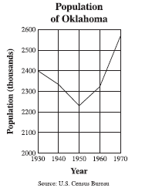
What caused this trend?
What did the government do about it?

