Slide 1
You will NOT receive credit for the session if you:
Fail to work on your question sheet;
Place your head on the desk/sleep;
Socialize/Visit/Talk with others during the session;
Arrive late and/or leave early;
Have your cell phone out.

Slide 2
World War II
After-School Review #8

Slide 3
Where would this poster most likely be displayed?

Slide 4
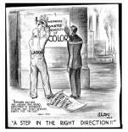
Whose efforts led to the development pictured at left?
Martin Luther King Jr.
A. Phillip Randolph
W.E.B. DuBois
Langston Hughes
What did he do in order to make this a reality?

Slide 5
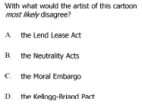
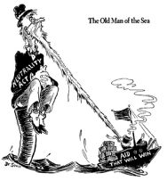

Slide 6
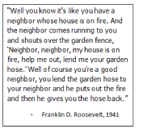
For what purpose did President Franklin Roosevelt most likely make this argument for breaking the Neutrality Acts?
To sign the Atlantic Charter
To implement the Lend-Lease Act
To trade with the Allied Powers
To trade with the Axis Powers

Slide 7
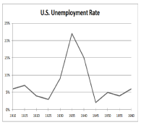
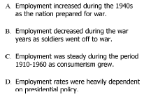
20%
10%
1910
1920
1930
1940
1950
1960
Which statement is best supported by the information in this graph?

Slide 8
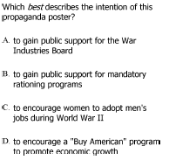
Who is pictured in the poster below?

