Slide 1
Chapter 10: Christendom
Part II:
Western Christendom &The West in Comparative

Slide 2
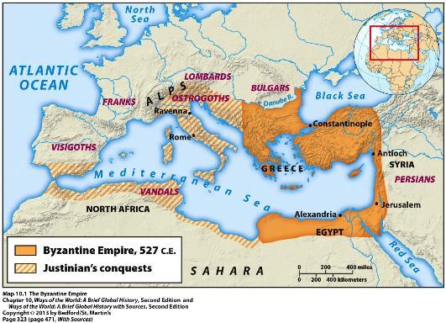
Western Christendom: Rebuilding in the Wake of Roman Collapse
Class Discussion Questions:
What was lost with the fall of Rome?
What aspects of Rome survived?

Slide 3
Answers:
W/ the overthrow of the last Roman emperor in the west by the German general Odoacer, Rome officially fell.
Long term decline of central authority and civilization in the west.
Central political authority collapsed, cities shrunk, literacy was lost, roads fell apart, trade broke down, barter replaced standard currency, disease
Mediterranean = fell apart; Northwest Europe = aspects survived
Germanic people adopted Roman law and military organization

Slide 4
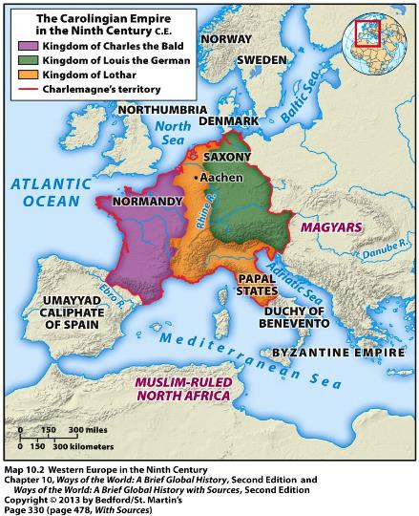
Germanic Kingdoms attempt to recreate Roman Style Unity
Charlemagne (768-814C.E.) acted “imperial”
Revival of Roman Empire on Christmas Day 800 (coronation of Charlemagne); soon fragmented
Another revival of Roman Empire with imperial coronation of Otto I of Saxony (936-973C.E.) would take title of Holy Roman Empire

Slide 5
Society and the Church
Within these new kingdoms:
Highly fragmented, decentralized society
Great local variation
Landowning warrior elite exercised power
Social hierarchies
Lesser lords and knights became vassals of kings or great lords
Serfdom displaced slavery
Catholic Church was a major element of stability
Hierarchy modeled on that of the Roman Empire
Became very rich
Conversion of Europe’s non-Christians (Capitulary of Saxony)
Most of Europe was Christian (with pagan elements) by 1100

Slide 6
Society and the Church
Church and ruling class usually reinforced each other.
Also elements of competition as rival center of powers
Right to appoint bishops and the pope was controversial (the investiture conflict)

Slide 7
Accelerating Change in the West
Invasions in 700-1000C.E. hindered development
Weather improved
High Middle Ages = clear growth and expansion
Growth of long-distance trade
Town and city populations rose
Growth of territorial states with organized gov’ts
New Opportunity for women
New ideas about masculinity: warrior to “provider”

Slide 8
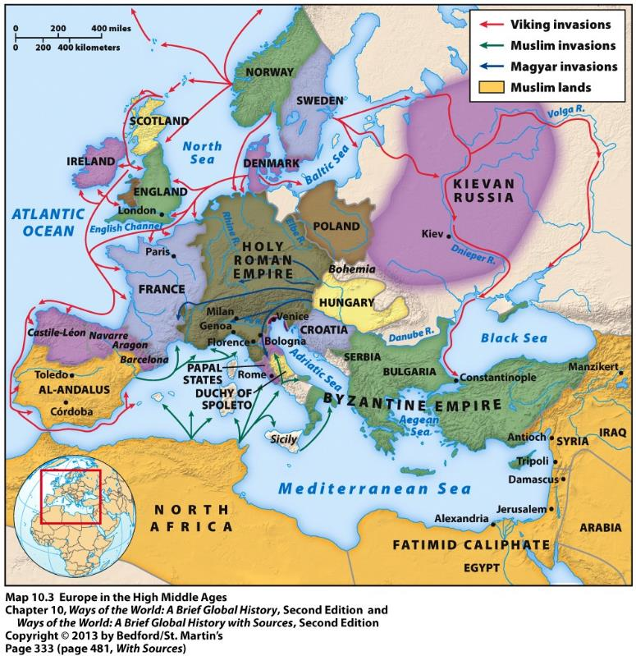

Slide 9
The Crusading Tradition
Medieval expansion of Christendom after 1000C.E
Same time as Byzantium declined
Clearance of land, especially on eastern fringe of Europe
Scandinavian colonies
Europe had direct, though limited, contact w/ Asia (13-14th)
Crusading movement began in 1095
Wars at God’s command, authorized by the pope, for which participants received an indulgence
Amazingly popular; were religious wars at their core

Slide 10
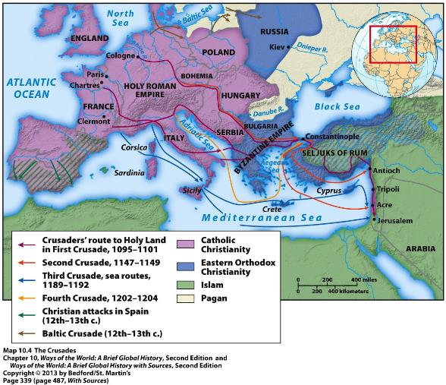
Crusades – regain Jerusalem
Many waves of crusaders to Near East
Creation of four small Christian states
Showed Europe’s growing organizational ability

Slide 11
Other Crusades
Iberian Peninsula Crusade
Baltic Crusade
Attacks on Byzantine Empire and Russia
Crusades had a significant impact on Europe:
Conquest of Spain, Sicily, Baltic Region
Crusaders weakened Byzantium
Popes strengthened their position for a time
Tens of thousands of Europeans made contact with the Islamic world
Europeans developed taste for luxury goods of the East
Muslim scholarship and Greek learning flowed into Europe
Hardened cultural barriers between peoples

Slide 12
The West in Comparative Perspective
Catching Up
Hybrid civilization of Western Europe was less developed
Muslim viewed Europeans as barbarians
Europeans were happy to exchange with/borrow from more advanced civilizations to the east
Europe was a developing civilization
By 1500 Europe had caught up and passed China and the Islamic world
500 – 1300 was a period of great innovation
Agriculture, warfare

Slide 13
Pluralism in Politics
Europe crystalized into a system of competing states
Political pluralism shaped Western Europe civilization
Wars and militarization
Stimulated technological development
Rulers were generally weaker than those to the east
King, nobles, the church struggled for power → Merchants
Development of representative institutions (parliaments)

Slide 14
Reason and Faith
Distinctive intellectual tension between faith and reason developed
Intellectual life flourished in the centuries after 1000 → Universities
Development of “natural philosophy”
Search for classical Greek texts
Aristotle had deep impact, dominating European thought
No similar development occurred in the Byzantine Empire
Suspicious of classical Greek thought
Islamic world had deep interaction with classical Greek thought
Massive translation causing a flowering of Arab scholarship
Islamic world eventually turned against natural philosophy

