Slide 1
From Boom to Bust

Slide 2
BIG IDEA
Although the 1920’s were prosperous, speculation in the stock market risky lending policies, overproduction, and uneven income distribution eventually undermined the economy and led to the Great Depression.

Slide 3
1928 Election
By the election of 1928, America was on a high. The “roaring 20’s” had turned the United States into the World’s leading economy and many Americans prospered.
Claiming that their pro-business policies were responsible for this prosperity, Republicans easily won the presidential election of 1928, electing (1) Herbert Hoover to the White House.
In his inaugural speech, Hoover boldly declared, “I have no fears for the future of our country. It is bright with hope.” But boy was he wrong!!!

Slide 4
Republicans of the 1920’s

Slide 5
Underlying Issues: Farmers
Although the American economy had been surging throughout the 1920’s, the underlying foundation was not strong and not everyone benefitted from the growing economy.
The first group to be left behind were the (2) farmers.
Farmers had done well during World War I because they were supplying food to all of the Allies; however, after the war, Farmers continued to overproduce resulting in a drop in prices.
Furthermore, (3) new technology made it harder for smaller farmers to compete and (4) tariffs from the government made it even harder for farmers to sell their goods overseas.
As a result, the Great Depression began for farmers at the beginning of the 1920’s.

Slide 6
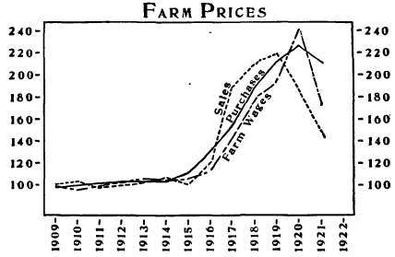
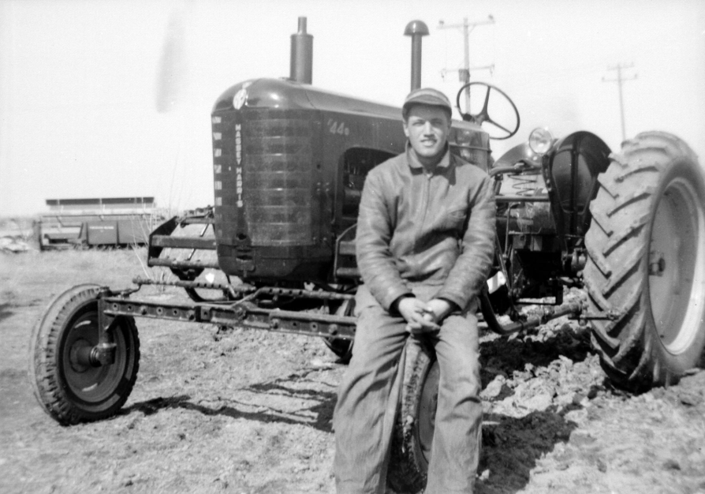

Slide 7
Underlying Issue: Overproduction
Another underlying problem that led to the Great Depression was (5) overproduction.
In the first part of the 1920’s, factories had ramped up production with the introduction of the assembly line. At first, they were able to sell these excess goods for large profits, but soon demand began to fall.
As demand fell in one sector, it soon fell in others. For example, the decrease in demand for automobiles led to a decrease in demand for rubber, glass, and steel.
These decrease in demand hurt businesses and even forced some to close.
Furthermore, as people bought products using (6) installment plans, they soon ran out of money to spend on new products.

Slide 8
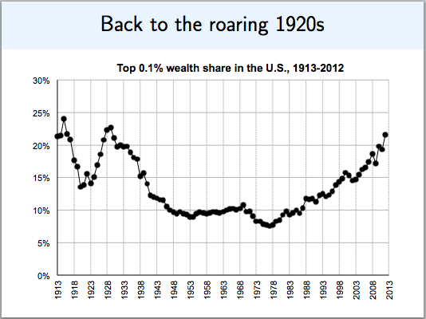

Slide 9
Underlying Problems: Tariffs
Adding to this problem was Congress’s use of the (7) tariff.
They believed that by putting tariffs on foreign businesses that they were helping American businesses be more competitive.
However, this actually hurt American businesses because it started a (8) trade war and made it harder for American businesses to sell their products in overseas markets.
The most famous of these tariffs was the (9) Hawley-Smoot Tariff passed in 1929.
As business slowed down, (10) unemployment rose, beginning a negative cycle that would seem near impossible to stop.

Slide 10
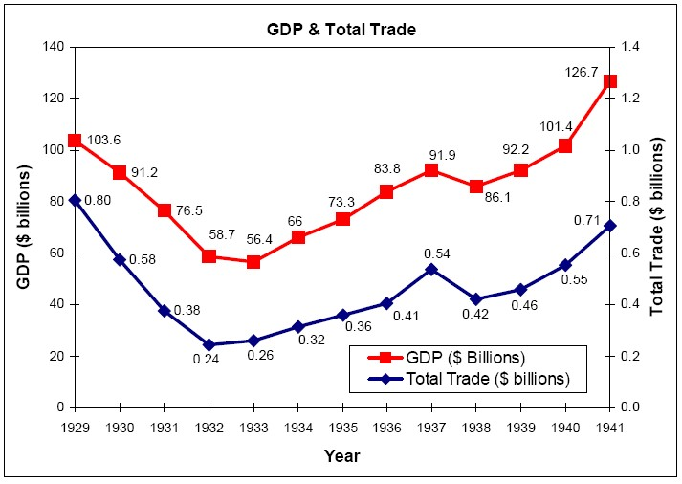

Slide 11
Stock Market
All of these underlying problems came to a boil in 1929.
Throughout the 1920’s, the (11) stock market had soared at unprecedented rates.
Investors were optimistic about the American economy and believed that they could make fast and easy money by investing in businesses.
This led to (12) speculation, which means investors took a risk hoping to make money.
Investors even began buying on (13) margin, which means they paid a small down payment for the stock and taking a loan for the rest from a stockbroker.
Soon, the stocks were worth more than their value.

Slide 12
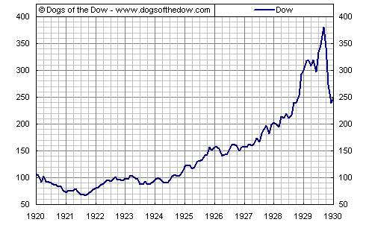

Slide 13
BIG IDEA
The Great Depression caused large numbers of people to lose their jobs and prosperity.
To help people escape their misery, popular entertainment offered humorous and optimistic movies and radio programs.
Novelist and photographers created more realistic portrayals of American life.

Slide 14
Black Tuesday
As investments in the stock market began to slow, investors started pulling their money out of the stock market.
This created a panic and a downward spiral which culminated on October 29, 1929, when the stock market crashed. This day became known as (14) Black Tuesday
Although this was not the main cause of the Great Depression, it is considered to be the starting point of the Depression.

Slide 15
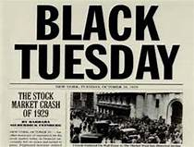
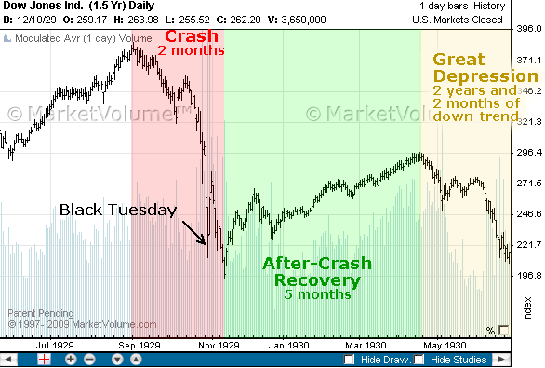

Slide 16
Banks Close and Depression Sets In
As a result of the stock market crash, America’s banking system was greatly weakened.
Banks began making fewer loans, making it harder for businesses to grow and for people to borrow money.
Furthermore, many banks were forced to close which caused many people to panic and run to their bank and take out all of their money.
These (15) Bank Runs resulted in even more bank failures and drove the economy even deeper into a recession.

Slide 17
The Great Depression Begins
By the end of 1929, the “roaring 20’s” had come to a screeching halt. The next decade would be filled with hardship for most Americans, as the country tried to pull itself out of the Great Depression. Unemployment rose, people lost their homes, and times were tough.

Slide 18
BIG IDEA
The Great Depression caused large numbers of people to lose their jobs and prosperity.
To help people escape their misery, popular entertainment offered humorous and optimistic movies and radio programs.
Novelist and photographers created more realistic portrayals of American life.

Slide 19
The Depression Worsens
The Depression grew steadily worse during (1) Herbert Hoover’s administration. More than 9,000 banks had failed by 1933; more than 30,000 companies went out of business; and more than 12 million people were out of a job.
Struggling to Get By
In the cities people struggled to eat. The (2) Salvation Army fed more than 12,0000 people daily in soup kitchens.
People were evicted from their home because they could not afford to pay rent/mortgage.
As result, shanty towns formed. These were makeshift shacks on unused or public land. They were nicknames (3) Hooverville's because many people blamed President Hoover for their situation.

Slide 20
The Depression Worsens
C. The Dust Bowl
As a result of this natural disaster many farmers on the Great Plains were forced to migrate to (8) California in search for jobs.
Californians did not like these workers and called them (9) Okies, as many were from Oklahoma

Slide 21
The Depression Worsens
C. The Dust Bowl
Although life was already hard for farmers because of overproduction and new technology, things got worse for farmers on the Great Plains in the 1930s.
A series of freak events led to what became known as the (4) Dust Bowl
This natural disaster had many different causes:
(5) Over farming-farmers had uprooted the grass that held the soil’s moisture and had not allowed the land to repair itself.
(6) Drought- The Great Plains went many months without any rain.
(7) Winds-twister like winds would collect the dust and make storms that covering everything. There were 72 storms in 1934 killing both humans and animals.

Slide 22
II) Art & Entertainment
The hard times of the 1930s led many Americans to prefer entertainment that let them escape their worries.
For example, (10) Comic books became popular and the first tales of Superman were published in 1938 and Batman in 1939
(11) Walt Disney created Mickey Mouse and the first full length animated film Snow White and the Seven Dwarves in 1937, and the Wizard of Oz came out in 1939
Literature and art
While movies and the radio tended to promote a more optimistic view of life, art and literature tended to be more realistic.
(12) John Steinbeck described the plight of Great Plains farmers traveling from Oklahoma to California in his world famous book, The Grape of Wrath

Slide 23
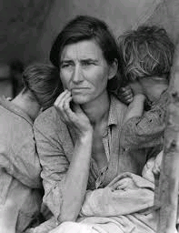
II) Art & Entertainment
Literature and art
(13) Dorothea Lange took pictures of people suffering in the depression to show how the average American had be affected.
These artist viewed the average American as the real heroes, no Superman and Batman in the comic books.

Slide 24
III. Hoover Responds to the Depression
As average Americans struggled to get by, Herbert hoover attempts to alleviate the misery of the country.
At first, Hoover believed the Depression would be short term, proclaiming, “the worst effects of the crash upon employment will have passed during the next sixty days.”
Even as the Depression got worse, Hoover did not want to interfere in the economy. He believed that government involvement would make things worse in the long run.
Instead he called for a policy of (14) Rugged Individualism. His belief was that Americans should pull themselves up and not rely on the government. He did not believe in (15) direct relief

Slide 25
III. Hoover Responds to the Depression
However, with no end in sight, Hoover soon changed his tune. He soon began funding (16) public works like the Hoover Dam to give people jobs and eventually even offered direct relief for suffering Americans.
He also started the (17) Reconstruction Finance Corporation which made loans to businesses. However, they did not offer enough money to reverse the negative business cycle that had set in.

Slide 26
IV. Too little, too late
Although Hoover began attempting to offer more relief to the American people, it was too little, too late
Hunger marches cropped up around the country. Some farmers began burning their crops to create a shortage in order to raise prices. The country was terribly upset with Hoover and tired of “pro-business” Republicans.
The worst incident occurred in Washington, D.C. in the summer of 1932
Texas congressman introduced bill that old allow World War I veterans to receive a $1,000 bonus to help them during the Depression

Slide 27
The First New Deal
Big Idea: Franklin Delano Roosevelt was elected president in 1932, following his promise of a “new deal” for Americans. In his first 100 days in office, he let loose a flood of legislation designed to rescue banks, industry, and agriculture and provide jobs for the unemployed.

Slide 28
I. Roosevelt’s Rise to Power
Roosevelt was a natural born politician. He had a charming personality and expressed confidence and optimism wherever he went.
He was the vice presidential candidate for the 1920 election, but soon after contracted the paralyzing disease, (1)polio.
Nevertheless, Roosevelt continued to work in politics and ran for governor of New York in 1928 and won.
His popularity as governor of New York helped him win the nomination for presidency in 1932 where he easily defeated the Republican incumbent (2) Herbert Hoover
In his acceptance speech for the democratic nomination, Roosevelt promised the American people something different from the Republicans, a (3) ”New Deal” This became the name of his program to help dig America out of the Great Depression.

Slide 29
II. The Hundred Days
In his inaugural address, President Roosevelt famously comforted the American people declaring, “Let me assert my firm belief that the only thing we have to fear is fear itself…This nation asks for action, and action now!”
Unlike Hoover, Roosevelt was quick to action in helping the American people through the Depression. In the (4)First One hundred Days Roosevelt did the following things:
(5) Bank holiday- He closed all banks temporarily to prevent people from taking all of their money out, thus closing the banks permanently. Congress then passed a law declaring that the banks must be examined before they were allowed to reopen.
He established a (6)Brain Trust of different people from all over the country to help come up with creative solutions for the Depression.
He sent numerous pieces of legislation to Congress to help relieve the American people.
He gave (7) fireside chats to the American people through the radio to encourage them and keep their morale up.

Slide 30
III. The First New Deal Kicks In
Unlike Hoover, Roosevelt was not afraid to provide (8)direct aid for the American people by spending government money.
In fact, Roosevelt relied largely on a new theory of economics called (9) Keynesian economics to run his New Deal. This theory said it was necessary for government to use (10) deficit spending to get the economy going again.
With this strategy in mind, Roosevelt established three goals for his First New Deal. They became known as the three “Rs” of the New Deal. (Relief, Recovery, and Reform)
These three “Rs” had a whole “Alphabet Soup” of programs to go along with them, most of them funded by the government.

Slide 31
III. The First New Deal Kicks In: The Three “Rs”
(8)Relief - Roosevelt wanted to provide immediate relief with JOBS for the American people who were unemployed and struggling to take care of their families.
(9) Civilian Conservation Core (CCC) This government agency was created to put young men back to work immediately. They were hired to plant trees, fight forest fires, and build reservoirs.
(10) Civil Works Administration (CWA) The government directly hired 4 million people to build airports, roads, schools, playgrounds, and parks

Slide 32
III. The First New Deal Kicks In: The Three “Rs”
(11) Recovery - Roosevelt wanted to jolt the economy back into action and get the United States out of the Depression for good.
(12)Public Works Administration (PWA) – the government awarded contracts to construction companies to build highways, sewers, schools, and other government facilities.
(13) Tennessee Valley Authority (TVA) - This government project hired people to build dams across the South to provide electricity to rural areas in Tennessee, Alabama, and Mississippi.
(14) Agricultural Adjustment Administration (AAA) – This law addressed the overproduction of farmers. It allowed the government to pay certain farmers NOT to grow food or NOT produce milk. In turn, this would raise the prices of crops.
(15) National Industrial Recovery Administration (NIRA) This law allowed businesses, government, and labor unions to work together to form “codes” for each industry. These codes set prices, established minimum wages, and limited factories to two shifts per day.
() ___________________ - Roosevelt wanted to make sure that the United States never experienced another Great Depression in the future.
()______________ ________________ _________________ __________________ (FDIC) This provided insurance for people’s money in the bank. If banks went under again, the United States’ government would pay people the money that they lost.
()_________________ _______________________ ___________________ (SEC) – This agency was created to regulate the stock market and prevent fraud.
Some of these organizations were more effective than others. Furthermore, some of these organizations were declared UNCONSTITUTIONAL by the Supreme Court, which said that Roosevelt had gone too far with his New Deal.

Slide 33
III. The First New Deal Kicks In: The Three “Rs”
(16) Reform - Roosevelt wanted to make sure that the United States never experienced another Great Depression in the future.
(17) Federal Deposit Insurance Commission (FDIC) This provided insurance for people’s money in the bank. If banks went under again, the United States’ government would pay people the money that they lost.
(18) Securities and Exchange Commission (SEC) – This agency was created to regulate the stock market and prevent fraud.
Some of these organizations were more effective than others. Furthermore, some of these organizations were declared UNCONSTITUTIONAL by the Supreme Court, which said that Roosevelt had gone too far with his New Deal.

Slide 34
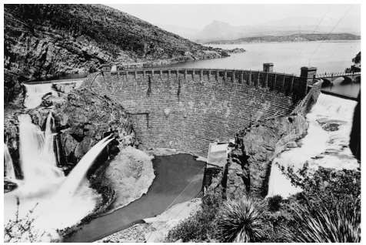
This is a photograph of a structure in Arizona built as part of the National Reclamation
Act of 1902.
What impact did this structure have on the southwestern United States?
A It caused flooding and led to decreased crop yields in the area.
B It became a popular tourist attraction, prompting the government to make it the first national park.
C It allowed the federal government to create reservoirs and control irrigation in the area.
D It promoted the privatization of water rights, allowing large companies to charge farmers for water.

Slide 35
Which statement best describes the economy of the United States during the 1920s?
A The economy grew because it was closely regulated by the federal government.
B The economy declined because fewer people were investing in the stock market.
C The economy grew because more consumer goods were available for people to purchase.
D The economy declined because farm surpluses increased the cost of food.

Slide 36
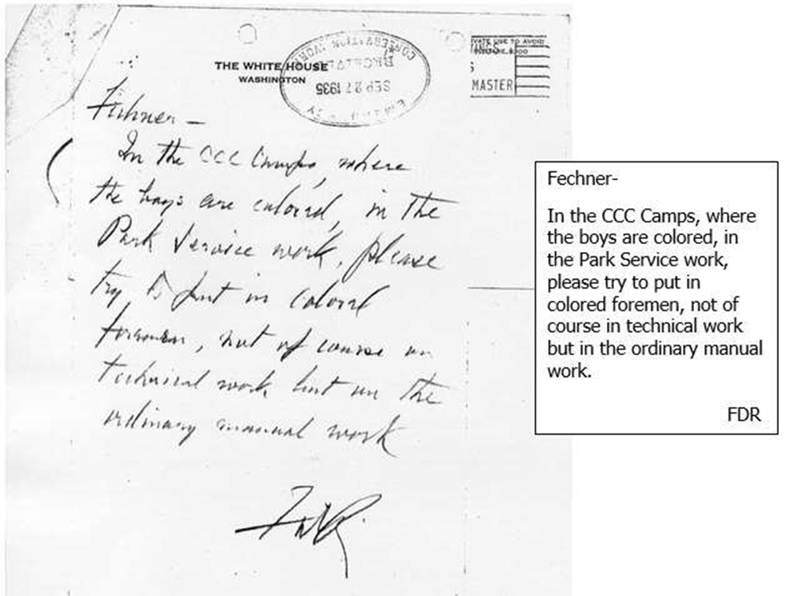
This is a letter sent by President Franklin D. Roosevelt to Robert Fechner, the director of the Civilian Conservation Corps (CCC).
This letter is evidence of what idea?
A New Deal programs failed to provide any jobs or direct assistance to African American workers.
B New Deal programs provided African Americans with opportunities to work alongside white workers.
C Despite efforts aimed at helping African Americans, racial discrimination and bias existed in New Deal programs.
D Despite working in segregated units, African American workers in New Deal programs were treated equally.

Slide 37
As part of his New Deal program, how did President Franklin D. Roosevelt propose to address the issue of poverty among older Americans?
by raising the minimum retirement age
by employing older Americans in less strenuous public works projects
by establishing senior centers to provide for older Americans
by establishing a government-run pension program

Slide 38
This is an excerpt from a speech given by President Herbert Hoover on June 16, 1930.
There are certain industries which cannot now successfully compete with foreign producers because of lower foreign wages and a lower cost of living abroad, and we pledge the next Republican Congress to an examination and, where necessary, a revision [to import taxes] to the end that American labor in these industries may again command the home market, may maintain its standard of living, and may count upon steady employment in its accustomed field.
Based on this excerpt, President Hoover supported what action?
increasing the number of government jobs
enacting free trade agreements
raising tariff rates
providing subsidies to farmers

Slide 39
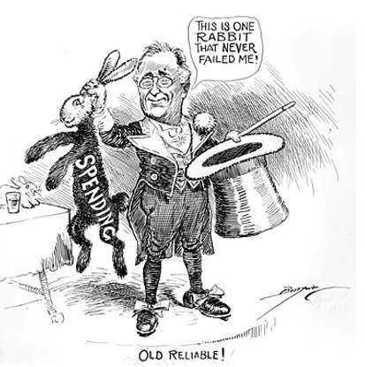
This political cartoon depicts President Franklin D. Roosevelt and was published in 1938.
This political cartoon reflects what criticism of President Roosevelt?
A His policies had negative effects on the environment.
B His policies increased the national debt.
C His policies lacked consistency.
D His policies cut too much spending to be successful.

Slide 40
This is a quote from a speech given by Franklin D. Roosevelt in 1932.
…I pledge you, I pledge myself, to a new deal for the American people. Let us all here assembled constitute ourselves prophets of a new order of competence and of courage. This is more than a political campaign; it is a call to arms. Give me your help, not to win votes alone, but to win in this crusade to restore America to its own people.
How did the message of this speech ultimately impact the role of the government?
It reduced government regulations on industries and the environment.
It gave state governments the primary responsibility for enacting social welfare programs.
It increased the power of the federal government to control the economy.
It increased government spending on defense programs to protect the nation.

