Slide 1
U.S. Presidents

Slide 2
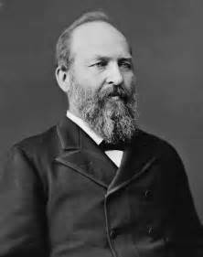
James Garfield
1881
Assassinated
His assassination resulted in the Pendleton Civil Service Act

Slide 3
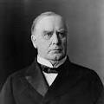
William McKinley
1897-1901
Republican
President during the Spanish-American War
His vice president was Theodore Roosevelt
He was also assassinated

Slide 4
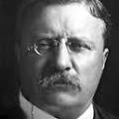
Theodore “Teddy” Roosvelt
1901-1909
Republican
First Progressive President
Known as the “Trust-Buster”
Square Deal
Pure Food and Drug Act
Meat Inspection Act
Conservation
Big Stick Diplomacy
Corollary to the Monroe Doctrine
Bull-Moose Party

Slide 5
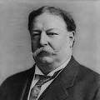
William Howard Taft
1909-1913
Republican
Hand-picked by Roosevelt but disappointed him
Second Progressive President
Payne-Aldrich Tariff
Dollar Diplomacy
Lost in split election between Roosevelt and Wilson

Slide 6
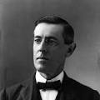
Woodrow Wilson
1913-1921
Democrat who won because of split election
Third and final Progressive president
Clayton Anti-Trust Act
Federal Reserve Act
Federal Trade Commission
Progressive Amendments
Moral Diplomacy
World War I
14 points

Slide 7
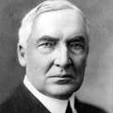
Warren G. Harding
1921-1923
Republican
“Return to Normalcy”
Palmer Raids
Emergency Quota Acts
Teapot Dome Scandal

Slide 8
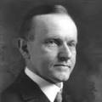
Calvin Coolidge
1923-1929
Republican
Pro-Business
“Keep Cool with Coolidge”
Restored trust in presidency after Harding

Slide 9
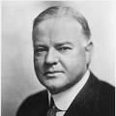
Herbert Hoover
1929-1933
Republican
Black Tuesday
Smoot-Hawley Tariff
Rugged Individualism
Bonus Army

Slide 10
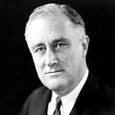
Franklin D. Roosevelt
1933-1945
Democrat (rejection of Hoover/Republicans)
Great Depression
New Deal
Keynesian Economics
Court-Packing Scheme
World War II
Lend-Lease
Manhattan Project
22nd amendment

Slide 11
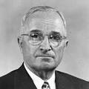
Harry Truman
1945-1953
Democrat
World War II
Hiroshima/Nagasaki
Fair Deal
Desegregated Military
Cold War
Truman Doctrine
Containment
NATO
Korean War

Slide 12
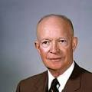
Dwight D. Eisenhower
1953-1961
Republican
Cold War
Eisenhower Doctrine
Brinkmanship
Covert Operations
Interstate Highway Act
Little Rock Nine
Military-Industrial Society

Slide 13
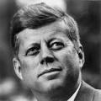
John F. Kennedy
1961-1963
Democrat
“Ask not…”
Bay of Pigs
Cuban Missile Crisis
New Frontier
Assassination in 1963
Warren Commission

Slide 14
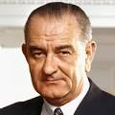
Lyndon B. Johnson
1963-1969
Democrat
Great Society
Civil Rights Act of 1964 and 1968
Voting Rights Act of 1965
24th Amendment
Vietnam War

Slide 15
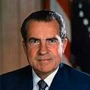
Richard Nixon
1969-1974
Republican (Silent Majority)
“Peace with Honor”
Vietnamization
Salt I (initiated)
Détente
Visit to China
EPA
Watergate Scandal

Slide 16
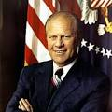
Gerald Ford
1974-1976
Republican
Pardoned Nixon
Helsinki Accords
SALT Treaty

Slide 17
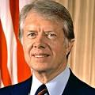
Jimmy Carter
1976-1980
Democrat
Energy Crisis (OPEC)
SALT II
Camp David Accords
Iran Hostage Crisis
Flailing economy

Slide 18
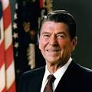
Ronald Reagan
1981-1989
Republican
“Evil Empire” Speech
Tough on Soviet Union and Gorbachev
Star Wars
Trickle Down Economics
Covert Ops in Central American
Iron-Contra Affair

Slide 19
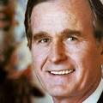
George H.W. Bush
Republican
1989-1993
Cold War ends during his tenure
START
Persian Gulf War
“No new taxes!” (yeah right)

Slide 20
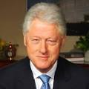
Bill Clinton
1993-2001
Democrat
World Trade Organization
NAFTA
Kyoto Protocol

Slide 21
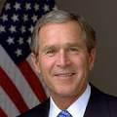
George W. Bush
2001-2009
Republican
9/11
Second Gulf War
War on Terror
Great Recession

Slide 22
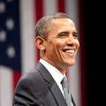
Barack Obama
2009-2017
Democrat
Stimulus Package
Affordable Care Act
Continued War on Terror

