Slide 1
The Second New Deal and the End of the Great Depression

Slide 2
The Second New Deal and the End of the Great Depression

Slide 3
Big Idea
Big Idea: In response to criticisms of the New Deal, President Roosevelt introduced several major pieces of legislation in 1935. These laws created the Works Progress Administration, the National Labor Relations Board, and the Social Security Administration.

Slide 4
Criticism from the Right
As the First New Deal settled in, many people accused Roosevelt of doing too much, while other criticized him for not doing enough.
People who thought he was doing too much included:
(1) Republicans who thought that the New Deal regulated business too tightly and was alarmed at the growing deficit.
(2) Southern Democrats who believed that the New Deal took away states’ rights.

Slide 5
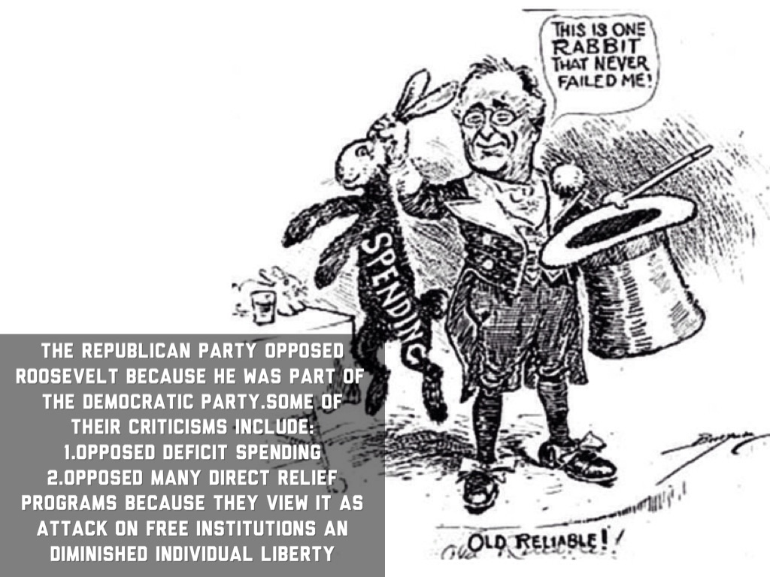

Slide 6
Criticism from the Supreme Court
But perhaps the most dangerous opposition was the (3) Supreme Court who declared many of FDR’s programs to be unconstitutional, thus shutting them down.
As a result of the Supreme Court’s opposition, FDR came up with a (4) Court Packing plan.
FDR appealed to Congress to change the number of Supreme Court justices from nine to fifteen. This would allow FDR to appoint the new justices, thus “packing” the court who would then rule in his favor.
This plan failed and many Americans felt that FDR had gone too far.

Slide 7
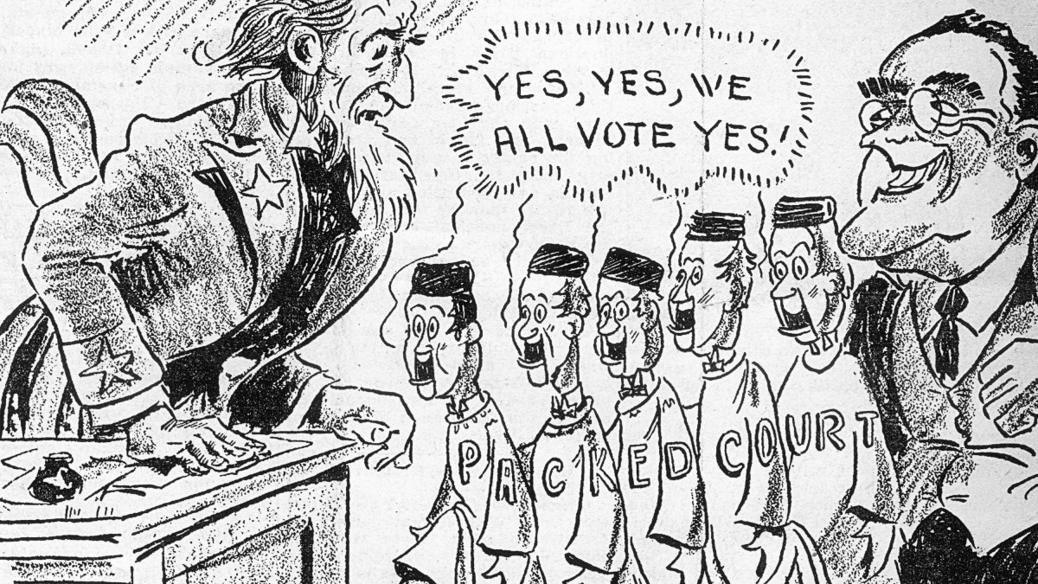

Slide 8
Criticism from the Left
People who thought that FDR was not doing enough included:
(5) Huey Long- Long was the governor of Louisiana.
He called for a (6)” Share our Wealth ” program in which every American would be guaranteed an income of $2,000 and no one would be allowed to make over one million dollars in a year
(7) Father Coughlin created the National Union for Social Justice which called for much higher taxes on the rich and for the government to take over the banks.

Slide 9
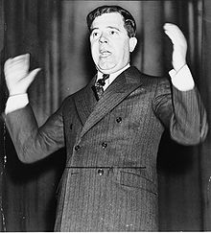

Slide 10
Second New Deal
Disturbed by the mounting criticism and the failure of the New Deal to generate a rapid economic recovery, FDR initiated his (8) Second New Deal in 1935.
The Second New Deal included even bigger and bolder programs:
(9) Works Progress Administration (WPA) – Spent 11 Billion dollars to put 8.5 million Americans back to work building highways, roads, public buildings, and parks.
(10) Social Security Act - This law provided security for older Americans and unemployed Americans by providing them with a paycheck. Americans over the age of 65 would be given a guaranteed income for retirement and people looking for a job would have a temporary income.

Slide 11
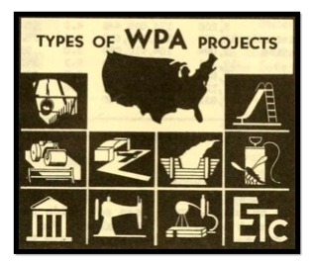
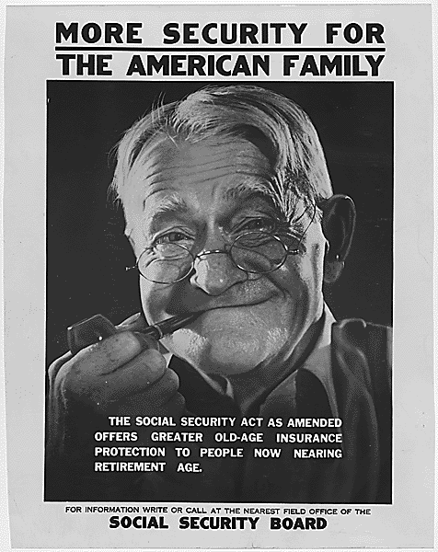

Slide 12
The New Deal and Labor Unions
FDR believed that labor unions could help bring an end to the depression by raising wages, giving more money to workers to spend.
Consequently, in 1935, he signed the (11) Wagner Act which gave labor unions the right to organize and collectively bargain for better wages and conditions.
This law led to the creation of many new labor unions and changed Americans’ attitudes towards labor unions.

Slide 13
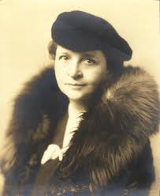
Frances Perkins
He also hired the first women cabinet member, (12) Frances Perkins as the Secretary of Labor.
Perkins fought on the side of labor unions and strongly supported workers’ rights.

Slide 14
1936 Election
In 1936, FDR’s New Deal was put up for a vote. If FDR won reelection, it meant that the American people generally supported his New Deal. If FDR lost, it meant that Americans had rejected the New Deal.
Although many thought it would be close, FDR won in a landslide. He carried every single state except Maine and Vermont and won sixty percent of the popular vote.
However, FDR faced criticism in 1937 when the economy hit a (13) recession. Unemployment went back up, and it seemed the New Deal was not fostering recovery.

Slide 15
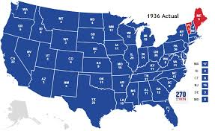

Slide 16
End of the Great Depression
As the New Deal suffered to jolt the economy back to life, another global catastrophe struck, (14) World War II
Soon America was producing crops and materials for the Allied Powers fighting Hitler.
This brought unemployment down to zero and pulled the United States out of the Great Depression.
However, now FDR faced a whole new problem.

Slide 17
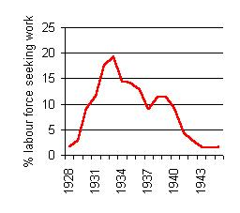

Slide 18
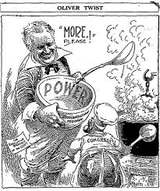

Slide 19
Quiz!!!
On the same sheet of paper you answered your reading questions, answer the following questions from pages 447-449.
1, 3, 7, 8, 9, 11, 13, 15, 16, 18

Slide 20
Big Idea
Big Idea: In response to criticisms of the New Deal, President Roosevelt introduced several major pieces of legislation in 1935. These laws created the Works Progress Administration, the National Labor Relations Board, and the Social Security Administration.

Slide 21
Criticism from the Right
As the First New Deal settled in, many people accused Roosevelt of doing too much, while other criticized him for not doing enough.
People who thought he was doing too much included:
(1) Republicans who thought that the New Deal regulated business too tightly and was alarmed at the growing deficit.
(2) Southern Democrats who believed that the New Deal took away states’ rights.

Slide 23
Criticism from the Supreme Court
But perhaps the most dangerous opposition was the (3) Supreme Court who declared many of FDR’s programs to be unconstitutional, thus shutting them down.
As a result of the Supreme Court’s opposition, FDR came up with a (4) Court Packing plan.
FDR appealed to Congress to change the number of Supreme Court justices from nine to fifteen. This would allow FDR to appoint the new justices, thus “packing” the court who would then rule in his favor.
This plan failed and many Americans felt that FDR had gone too far.

Slide 25
Criticism from the Left
People who thought that FDR was not doing enough included:
(5) Huey Long- Long was the governor of Louisiana.
He called for a (6)” Share our Wealth ” program in which every American would be guaranteed an income of $2,000 and no one would be allowed to make over one million dollars in a year
(7) Father Coughlin created the National Union for Social Justice which called for much higher taxes on the rich and for the government to take over the banks.

Slide 27
Second New Deal
Disturbed by the mounting criticism and the failure of the New Deal to generate a rapid economic recovery, FDR initiated his (8) Second New Deal in 1935.
The Second New Deal included even bigger and bolder programs:
(9) Works Progress Administration (WPA) – Spent 11 Billion dollars to put 8.5 million Americans back to work building highways, roads, public buildings, and parks.
(10) Social Security Act - This law provided security for older Americans and unemployed Americans by providing them with a paycheck. Americans over the age of 65 would be given a guaranteed income for retirement and people looking for a job would have a temporary income.

Slide 29
The New Deal and Labor Unions
FDR believed that labor unions could help bring an end to the depression by raising wages, giving more money to workers to spend.
Consequently, in 1935, he signed the (11) Wagner Act which gave labor unions the right to organize and collectively bargain for better wages and conditions.
This law led to the creation of many new labor unions and changed Americans’ attitudes towards labor unions.

Slide 30
Frances Perkins
He also hired the first women cabinet member, (12) Frances Perkins as the Secretary of Labor.
Perkins fought on the side of labor unions and strongly supported workers’ rights.

Slide 31
1936 Election
In 1936, FDR’s New Deal was put up for a vote. If FDR won reelection, it meant that the American people generally supported his New Deal. If FDR lost, it meant that Americans had rejected the New Deal.
Although many thought it would be close, FDR won in a landslide. He carried every single state except Maine and Vermont and won sixty percent of the popular vote.
However, FDR faced criticism in 1937 when the economy hit a (13) recession. Unemployment went back up, and it seemed the New Deal was not fostering recovery.

Slide 33
End of the Great Depression
As the New Deal suffered to jolt the economy back to life, another global catastrophe struck, (14) World War II
Soon America was producing crops and materials for the Allied Powers fighting Hitler.
This brought unemployment down to zero and pulled the United States out of the Great Depression.
However, now FDR faced a whole new problem.

Slide 36
Quiz!!!
On the same sheet of paper you answered your reading questions, answer the following questions from pages 447-449.
1, 3, 7, 8, 9, 11, 13, 15, 16, 18

