Slide 1
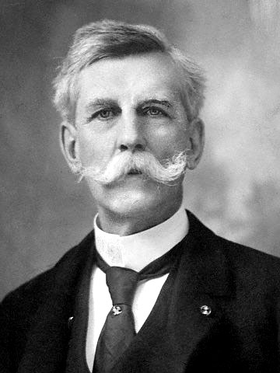
“Man's mind once stretched by a new idea, never to regains its original dimension.”
Oliver Wendell Holmes

Slide 2
The Centuries Surrounding 500 BCE
New cultural traditions emerged that spread widely
Occurring somewhat simultaneously in China, India, the Middle East, and Greece
Traditions differed greatly but impacted world history tremendously
Growing cities, increasing trade, new states, and new contacts as well as more deadly warfare led thinkers to question older perspectives and develop new answers

Slide 3
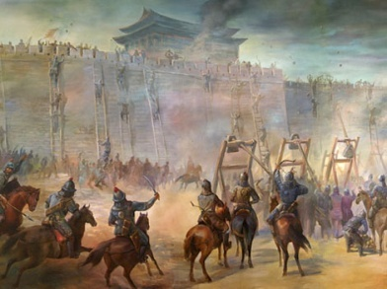
Disorder during the Zhou Dynasty
China had a tradition of state building that dated back to around 2000 BCE
By the time of Zhou dynasty took power in 1122 BCE, the Mandate of Heaven was an accepted Chinese belief
But by the eighth century BCE, the Zhou dynasty was seriously weakened
By 500 BCE, the age of warring states (403-221 BCE) had begun
Disorder led thinkers to develop new ideas

Slide 4
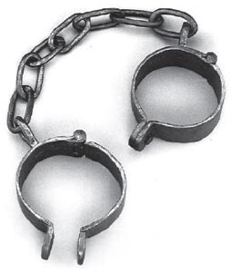
Legalism
Legalist philosophers believed that the solution to China’s problems lay in laws
A system of rewards and strict punishments
A pessimistic view of human nature
-People were selfish and shortsighted
-Only the state and rulers could act in the long-term interests of society
Promoted farmers and soldiers
-Believed these classes performed essential functions
-Regarded other classes as useless

Slide 5
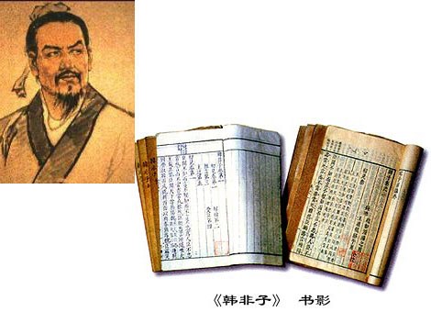
The great legalist philosopher, Han Feizi, once said, “If the rewards are high then what the ruler wants will be quickly effected; if the punishments are heavy, what he does not want will be swiftly prevented.”

Slide 6
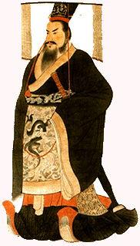
The qin dynasty
The dominant philosophy of the Qin dynasty (221 – 206 BCE) was Legalism
But the brutality of the dynasty discredited Legalism
No ruler afterwards openly supported it
But it, nonetheless, played a role in future dynasties
Even while the Han and subsequent dynasties officially endorsed Confucianism

Slide 7
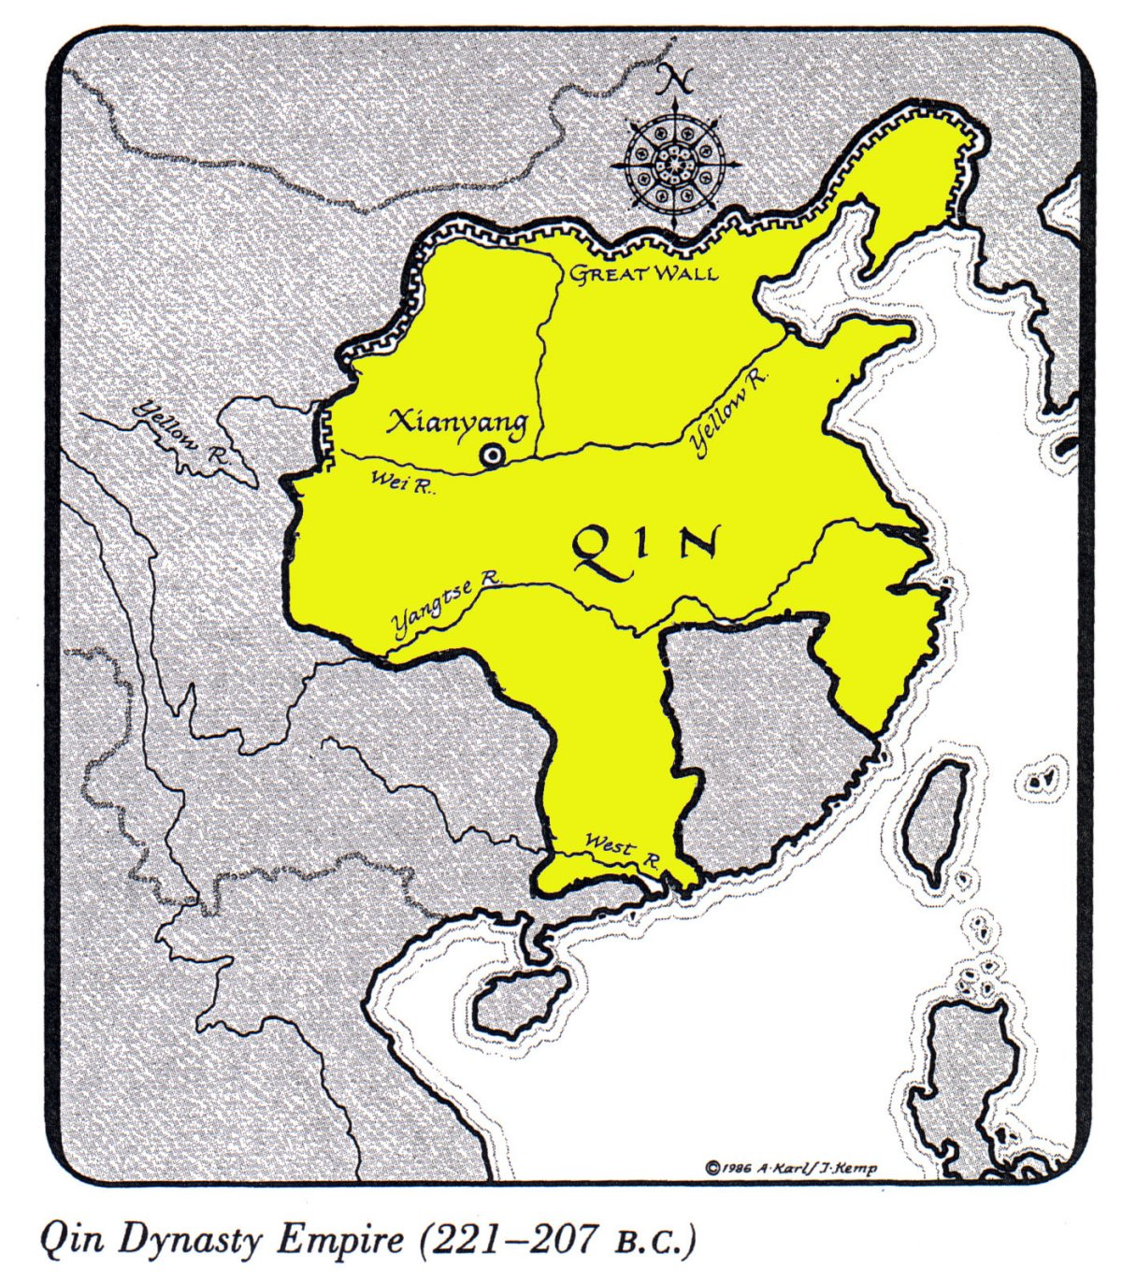

Slide 8
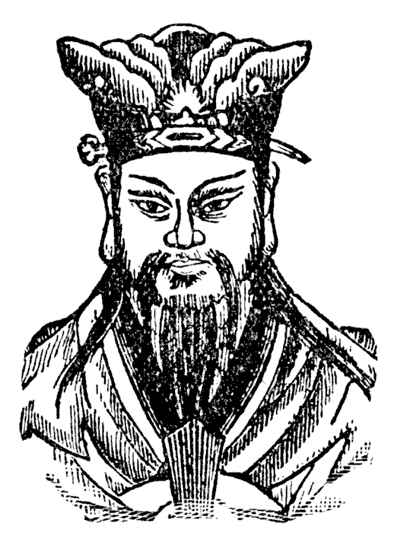
Confucius
Confucius (551 – 479 BCE) was the most influential philosopher of China’s dynastic period
Sought a political position but did not find one
Spent his time as a thinker and teacher
Students collected his teachings in a book called the Analects
Later scholars elaborated on his ideas and developed a body of thought known as Confucianism

Slide 9
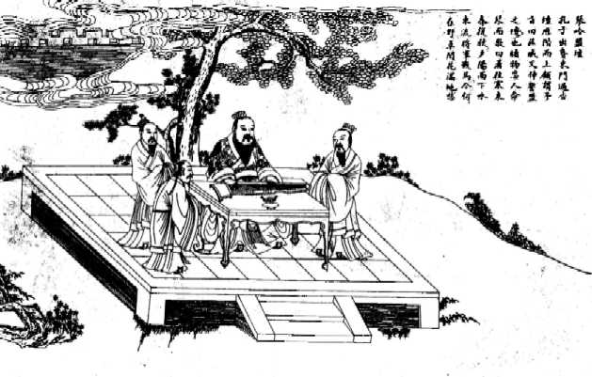

Slide 10
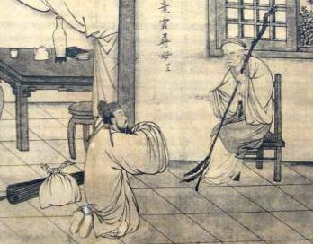
Differed from Legalism
-Not rewards and punishments
-But the moral example of superiors
Human society consisted of unequal relationships
To maintain order and thus social harmony, inferiors had to obey superiors
Superiors had to protect and provide for inferiors and set good examples
A superior acting with benevolence and genuine concern would motivate inferiors to respond with obedience
Proper behavior would lead to harmony and stability

Slide 11
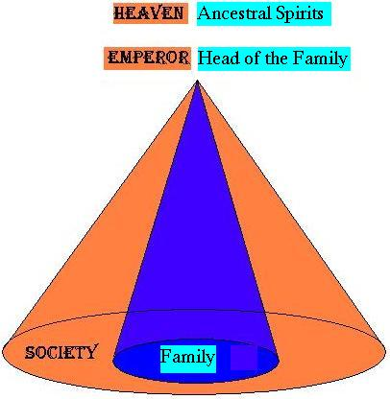

Slide 12
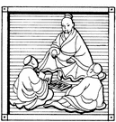
Confucius emphasized education as the key to moral betterment
Rituals and ceremonies were also important for they conveyed the rules of appropriate behavior
Encouraged a striving to perfect moral character
The Han dynasty encouraged Confucianism
The examination system was established in which candidates for government service had to pass a rigorous examination
-A civil service based on competence
The family was the model for political life
-Filial piety or the honoring of one’s ancestors and parents was emphasized

Slide 13
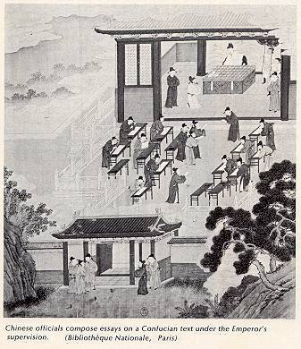

Slide 14
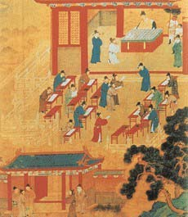
The family was a training ground for the reverence due to the emperor and state officials
Women were also affected by their status as permanent inferiors
-Trained to serve their husbands
Placed great importance on history for the ideal society lay in the past
Although Confucius was a reformer, his ideas were presented as an effort to restore a past golden age
But opened the possibility of government service to all men by emphasizing intellectual achievement and the examination system

Slide 15
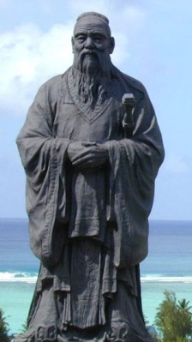
Justified inequalities of Chinese society
But also established certain expectations for government
-Emperors should keep taxes low
-Emperors should provide for the material needs of the people
-Emperors should administer justice
A failing emperor could forfeit the Mandate of Heaven and could be replaced by another dynasty
Confucianism also marked elite Chinese culture by its secular or nonreligious character
-His teachings were distinctly this-worldly and practical

Slide 16
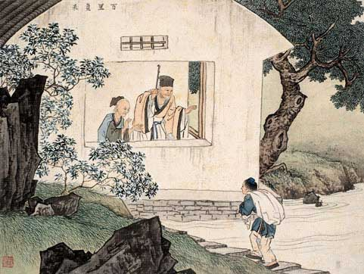
Confucius was concerned with human relationships, effective government, and social harmony.

Slide 17
According to Confucius, since humans could not fully understand this life, they could not possibly know anything about the life beyond.

Slide 18
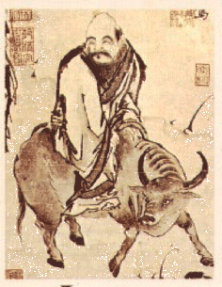
Daoism
Daoism is often associated with Laozi
According to tradition, Laozi was a sixth-century BCE archivist
Credited with writing the Daodejing (Tao Te Ching)
Afterwards, it was rumored that Laozi abandoned civilization to live in nature
Daoist ideas were later-expressed in a more explicit fashion by the philosopher Zhuangzi (369-286 BCE)

Slide 19
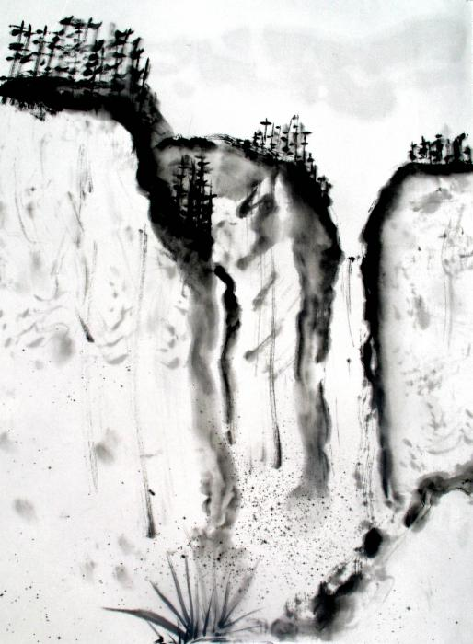
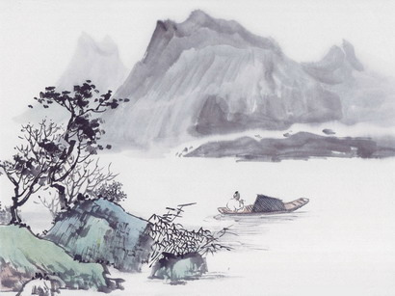

Slide 20
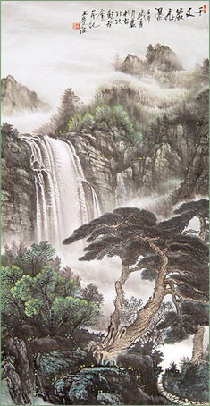
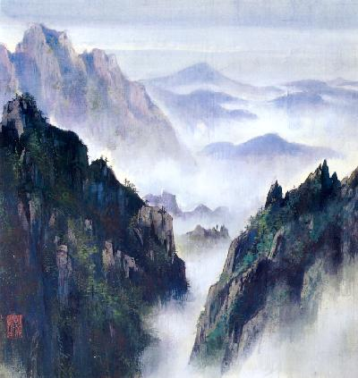
Daoism was radically different from Confucianism
Daoists viewed education and moral striving as useless
Opposed many Confucian ideas
Believed that striving made things worse
In the face of disorder and chaos, urged withdrawal into the world of nature
Encouraged behavior that was spontaneous, individualistic, and natural
Emphasized nature and its mysterious patterns

Slide 21
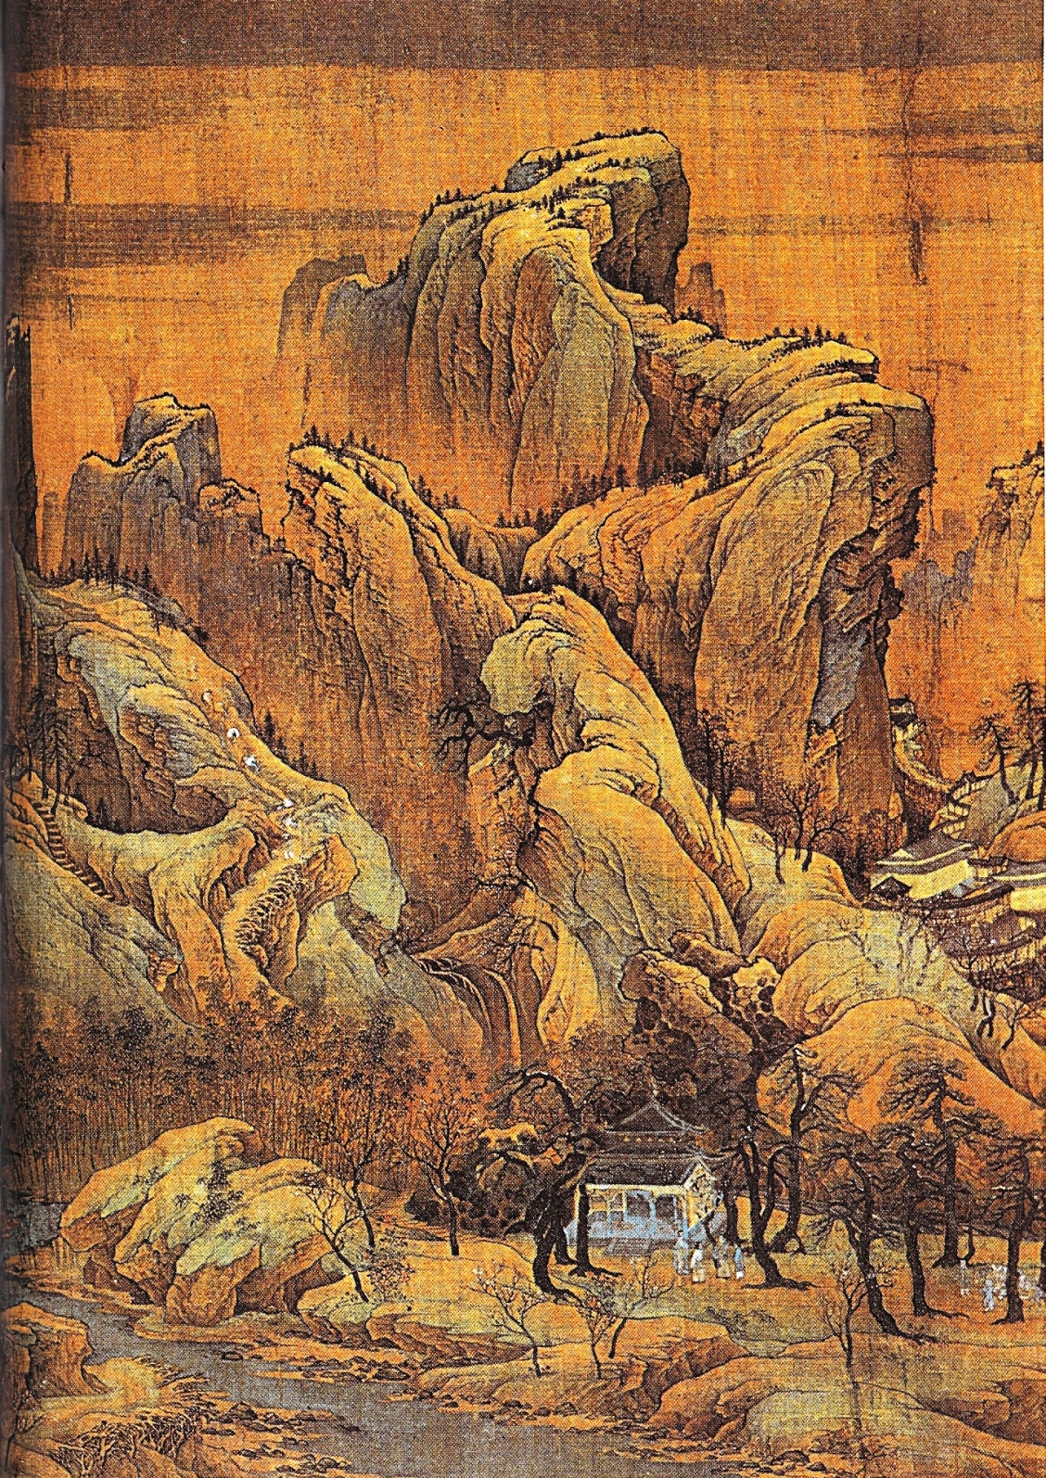

Slide 22
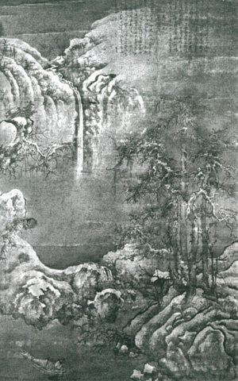
The central concept of Daoism is the Dao
It is often said that the Dao is beyond words
According to Daoists, the Dao cannot be fully defined
It is frequently translated as the Way
Daoism encouraged people to withdraw from the world of political and social activism
Daoism encouraged people to live in nature and to live naturally

Slide 23
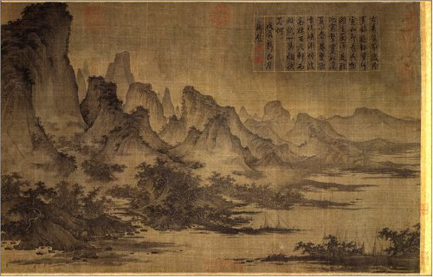

Slide 24
But despite differences, Daoism was regarded as complementing Confucianism
This attitude was encouraged by the ancient Chinese concept of yin and yang
The concept of yin and yang expressed a belief in the unity of opposites
A Confucian scholar during the day might practice Daoist meditation and breathing exercises as well as landscape painting at night

Slide 25
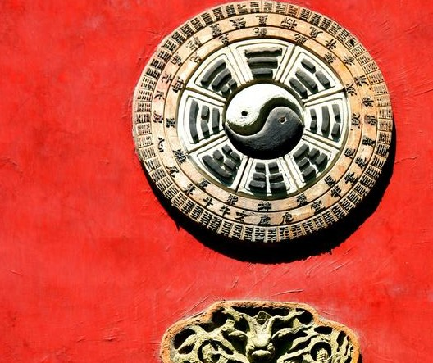
Daoism also entered the popular culture. This kind of Daoism sought to tap the Dao for practical purposes and came to include magic, fortune-telling, and the search for immortality.

Slide 26
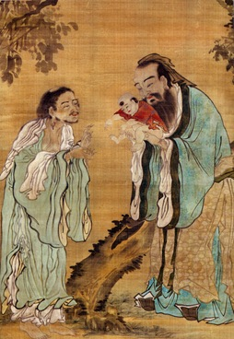
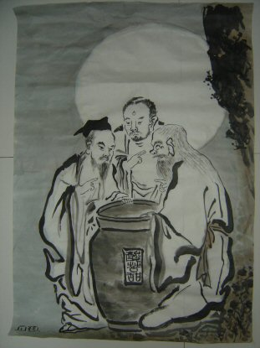
While Confucianism became the official philosophy of the dynastic period, Daoism like Legalism before it, impacted the Chinese experience too.

Slide 27
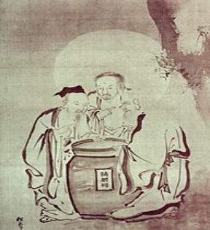
Strayer Questions
What different answers to the problem of disorder arose in classical China?
Why has Confucianism been defined as a "humanistic philosophy" rather than a supernatural religion?
How did the Daoist outlook differ from that of Confucianism?

