Slide 1
The Worlds of the 15th Century
Chapter 12-The Shape of Human Communities

Slide 2
Chapter 12 Introduction:
This is the last chapter in which the Americas, Australia, and Afro-Eurasia are separated and not part of one global network.
This chapter’s purpose is to review the human story up to the 16th century and to establish a baseline against which to measure the transformation of the period 1500-2000.

Slide 3
The Shapes of Human Communities
Paleolithic Persistence: Australia and North America
Gathering and hunting societies still existed throughout all of Australia, much of Siberia, the arctic coastlands, and parts of Africa and the Americas.
They had COT, interacted w/ neighbors.
Ex. Australian gatherers and hunters:
250 separate groups
Assimilated outside technologies and ideas (outrigger canoes, fish hooks, netting techniques, artistic style, rituals)
Had not adopted agriculture
“firestick farming”
Exchanged goods over hundreds of miles

Slide 4
Paleolithic Persistence cont.
Northwest coast of North America developed very differently.
Abundant environment = complex hunting and gathering culture
Had permanent villages, economic specialization, hierarchies that sometimes included slavery, chiefdoms, food storage
Elsewhere, farming had advanced and absorbed Paleolithic lands.

Slide 5
Agricultural Village Societies: The Igbo and the Iroquois
Predominated in much of North America, in parts of the Amazon River basin, Southeast Asia, and Africa.
Their societies mostly avoided oppressive authority, class inequalities, and seclusion of women.
Ex. of forested region in present day southern Nigeria:
15th century – Yoruba and Benin people had to develop small states and urban centers.
Igbo (EE-boh) peoples: dense population and trade, but purposely rejected kingship and state building.
Instead created a stateless society
Yoruba, Bini, and Igbo peoples traded among themselves

Slide 6
Agricultural Village Societies cont.
New York state, agricultural village societies underwent substantial change in the centuries before 1500.
Iroquois speakers had become fully agricultural (maize and beans) by around 1300.
Population growth, emergence of distinct peoples.
Rise of warfare as key to male prestige.
Warfare triggered the creation of the Iroquois confederation
Great Law of Peace (the Five Nations)
Some European colonists appreciated Iroquois values of social equality and personal freedom (even for women).

Slide 7
Pastoral Peoples: C. Asia & W. Africa
Turkic warrior Timur (Tamerlane) tried to restore the Mongol Empire (1400)
His army devastated Russia, Persia, and India
Timur died in 1405, while preparing an invasion of China.
His successors kept control of the area between Persia and Afghanistan for a century.
Timur’s conquest was the last great military success of Central Asian nomads.
In the following centuries, the steppe nomads’ homeland was swallowed up in expanding Russia and Chinese empires.

Slide 8
Pastoral Peoples: C. Asia & W. Africa
African pastoralists remained independent from established empires for several centuries longer.
Ex. Fulbe (W. Africa’s largest pastoral society)
Gradual eastward migration after 1000 C.E.
Usually lived in small communities among agriculturalists
Gradually adopted Islam
Some moved to towns and became noted religious leaders
Series of jihads in the 18th and 19th centuries created new states ruled by the Fulbe.

Slide 9
Civilizations of the 15th Century: Comparing China and Europe
By the 15th century, a majority of the world’s population lived within a major civilization.
Ming Dynasty China
China had been badly disrupted by Mongol rule & plague.
Recovery under the Ming Dynasty (1368-1644)
Effort to eliminate all signs of foreign rule
Promotion of Confucian learning
Emperor Yongle (1402-1422) sponsors an 11,000 volume Encyclopedia summarizing all the wisdom of the past
Reestablished the civil service examination system

Slide 10
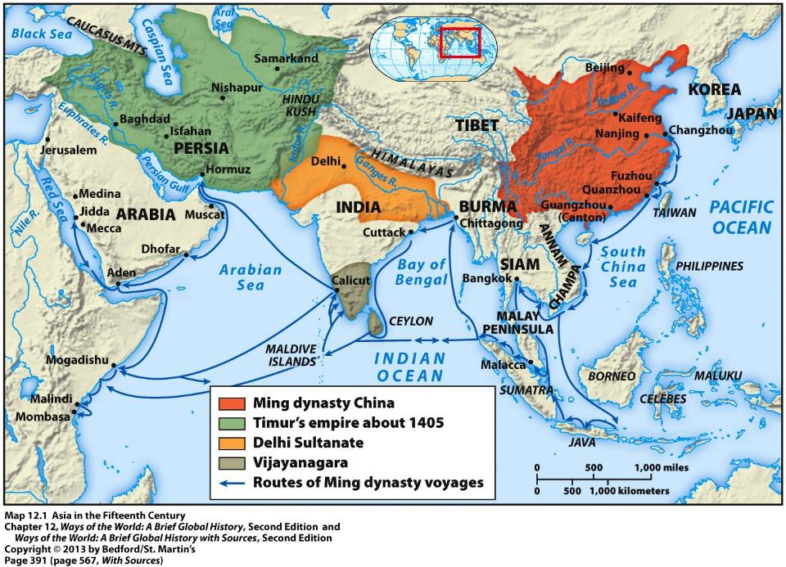

Slide 11
Ming Dynasty China cont.
Created a highly centralized government
Great power was given to court eunuchs
State restored land to cultivation, constructed waterworks, planted perhaps a billion trees.
Arguably the best-governed and most prosperous civilization of the 15th century.
Maritime ventures
Sailors and traders had become important in the South China Sea and in Southeast Asian ports in the 11th century.
Emperor Yongle commissioned a massive fleet (1405)
Abruptly stopped voyages in 1433 – waste of resources

Slide 12
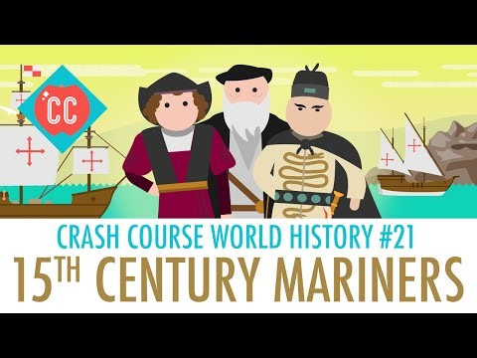
Zheng He

Slide 13
European Comparisons: State Building and Cultural Renewal
European population began to rise again in 1450.
State building, but fragmented, w/ many independent and competitive states.
The Renaissance
Commercial cities of Italy 1350-1500
“returning to the source” as a cultural standard to imitate
Turn to greater naturalism in art (turtles)
“humanists” scholars exposed secular topics in addition to religious matters
Christine de Pizan wrote against misogyny
Renaissance thinkers concerned w/ describing the world as is

Slide 14
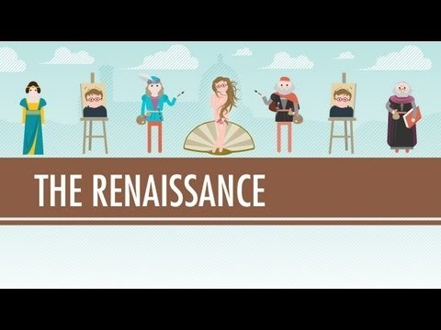
Renaissance

Slide 15
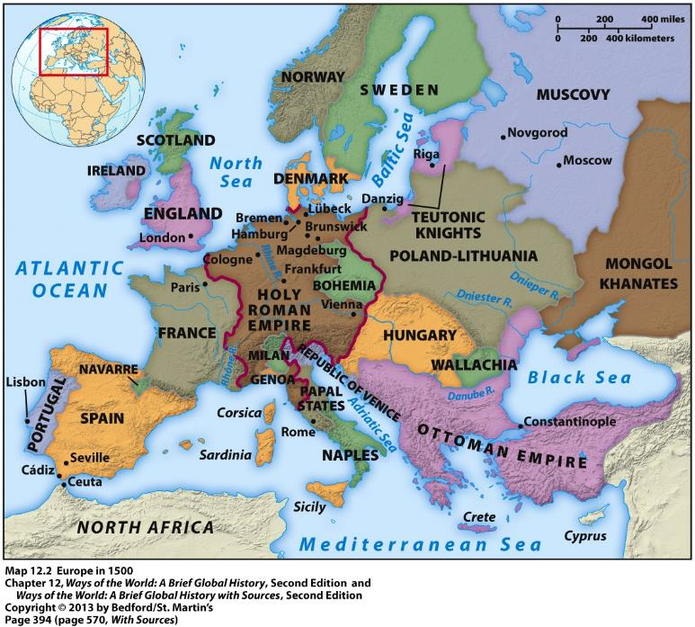

Slide 16
European Comparisons: Maritime Voyaging
Portuguese – 1415; Columbus – 1492; da Gama – 1497-98
European voyages much smaller
Unlike Chinese voyages, Europeans were seeking wealth, converts, allies
Europeans used violence to carve out empires
Chinese voyages ended; European one continued:
Rivalry between states encouraged exploration
European elite interested in overseas expansion
China had what it needed, Europeans wanted greater riches
China’s food production expanded internally, unlike Europe

Slide 17
