Slide 1
Chapter 12: The Worlds of the 15th Century
Part II: The Islamic World, The Americas, & Webs of Connections
PART 2- Identify and explain three ways that rulers legitimized or consolidated their power during the period of 600 CE to 1450 CE. Use specific examples from one or more states or empires.

Slide 2
Identify and explain three ways that rulers legitimized or consolidated their power during the period of 600 CE to 1450 CE. Use specific examples from one or more states or empires.
Religiously
Umayyad/Abassid Empire/ Holy Roman Empire
Conquest and Warfare
Islamic Empire/Mongols/Aztecs
Trade and Commerce
Song (china), Mongols
Technological Change
Europe/Mongols
Feudalism
Europe/China/Japan

Slide 3
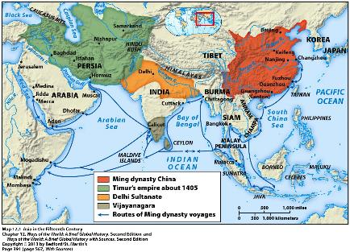
Civilizations of the 15th Century: The Islamic World
The long-fragmented Islamic world crystallized into 4 major states or empires.
Ottoman (used to be the Turks)
Safavid (Persian Empire of old)
Songhay/Songhai (West Africa of old)
Mughal (India)
“The Second Flowering of Islam”
New age of energy, prosperity, and cultural brilliance
Spread of Islam to new areas – SE Asia
Rise of Malacca (Muslim Port City – center for Islamic learning)

Slide 4
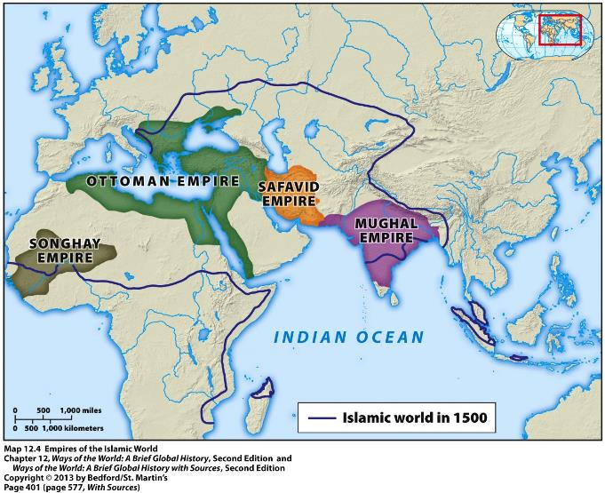
Islamic World in 1500

Slide 5
Ottoman Empire
Lasted from 14th to early 20th century
Huge Territory
Sultans claimed title of Caliph (Abbasids)
Tried to bring unity to Islamic world
Ottomans were aggressive towards Christian lands
Constantinople in 1453
Vienna in 1529
Europeans feared Turkish expansion (Janissaries)

Slide 6
Safavid Empire
Emerged in Persia from a Sufi religious order
Established shortly after 1500
Shia Islam
Periodic conflict between Sunni Ottoman Empire and Shia Safavid Empire between 1534 and 1639.

Slide 7
Songhay/Songhai Empire
Second half of 15th Century
Islam limited to urban cities
Sonni Ali (1465-1492) followed Muslim practices.
His successor made the pilgrimage to Mecca
“Caliph of the land of the blacks”
Songhay/Songhai Empire was a major center of Islamic learning/trade.

Slide 9
Mughal Empire
Created by a Turkic group that invaded India in 1526.
Over the 16th century, Mughals gained control of most of India.
Effort to create a partnership between Hindus and Muslims
Hindu Kingdom of Vijayanagara continued to flourish in the south.

Slide 11
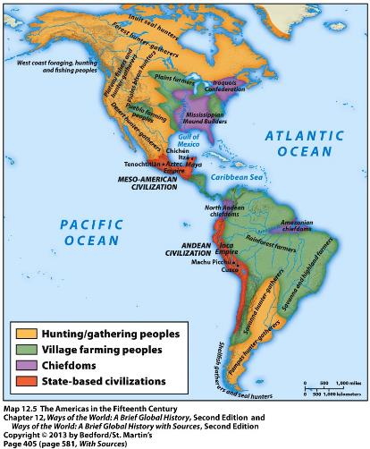
Civilizations of the 15th Century: The Americas
Aztec and Inca Empires – established by once-marginal peoples who took over and absorbed older cultures.

Slide 12
The Aztec Empire
The Mexica (Meh-sheeh-kah) were a seminomadic people who migrated southward from northern Mexico.
Established themselves on an island in Lake Texcoco by 1325
Built themselves up and established capital city of Tenochtitlan
Triple Alliance (1428)
Launched military conquest
Conquered much of Mesoamerica in under a century
Aztec rulers claimed descent from earlier peoples

Slide 13
Aztec Empire continued:
Aztec Empire was loosely structured, unstable conquest state
Population of 5-6 million
Conquered peoples paid tribute
Tenochtitlan = 150,000-200,000 people
Trade – done by pochteca (slaves)-KEY CONCEPT: Labor systems
Human sacrifice very prominent (legitimization of a ruler: religious)
Tlacaelel credited w/crystalizing ideology of the state, giving human sacrifice such important
Created an important philosophical/poetic tradition focused on fragility of human life.

Slide 14
The Incan Empire
Established by Quechua (kehtch-wah) speakers – Andes
Empire was 2,500 miles long (10 million subjects)
Inca more bureaucratic/centralized
Emperor was an absolute ruler regarded as divine (legitimizing rule- absolute power: politically)
State theoretically owned all land and resources
80 provinces w/ governor
Subjects grouped into hierarchical units of people
Inspectors checked up on provincial officials
Population data recorded on quipus (tying of knots)
Massive resettlement program moved much of population

Slide 15
The Incan Empire continued:
Attempted cultural integration
Leaders of conquered peoples had to learn Quechua
Sons were taken to Cuzco for acculturation
Subjects had to acknowledge major Inca deities
Almost everyone had to perform labor service (mita) for the state. (type of labor system)
Work on state farms, herding, mining, military service, state construction
Production of goods for the state
“chosen women”
State provided elaborate feasts in return
State played a large role in distribution of goods

Slide 16
The Incan Empire continued:
Both the Inca and Aztec civilizations practiced “gender parallelism”
Women and men operated in “separate but equivalent spheres”
Parallel religious cults for women and men
Incan men venerated the sun, women worshipped the moon
Parallel hierarchies of female and male political officials (especially among Incas)
Women’s household tasks were not regarded as inferior
Men had top position in political and religious life
Glorification of the military probably undermined gender parallelism
Inca ruler and his wife governed jointly

Slide 17
Webs of Connection
Large-scale political systems brought together culturally different people.
Religion both unified and divided far-flung people.
Patterns of trade were certainly evident in the 15th century.
No 15th century connections were truly global.

