Slide 1
Unit 8-The Inter-War Years

Slide 2
China
China continued to be weak during the early-1900s
China reacted violently to Treaty of Versailles giving Japan control of areas formerly controlled by Germany
  Students rebelled in what became known as “May 4th Movement” (student protests against the above that led to cultural and intellectual ferment in China)
    Some sought new Western ideas, others turned to Marxism, others still back to Confucianism
Desired reforms undertaken by Jiang Jieshi (Guomindang) and Mao Zedong (Communist) led their respective groups into a 22 year long civil war
  Zedong led Communists on the Long March to flee advancing Nationalist
    Massive loss of life, but endeared him/them to common people in China
Japanese attacks led the two groups to unify in fighting against the Japanese

Slide 3
Japan
Japan advanced (largely due to Meiji reforms) in early 1900s, but many were dissatisfied
Great Depression hit Japan with massive force, and caused many to clamor for territorial expansion to help the economy
  Invaded Manchuria (1931) on false pretense (and without government approval)
    League of Nations (and China) protested but Japan didn’t care
As a result of this, and other actions, the military (basically) controlled the Japanese government (and would lead her into World War II)

Slide 4
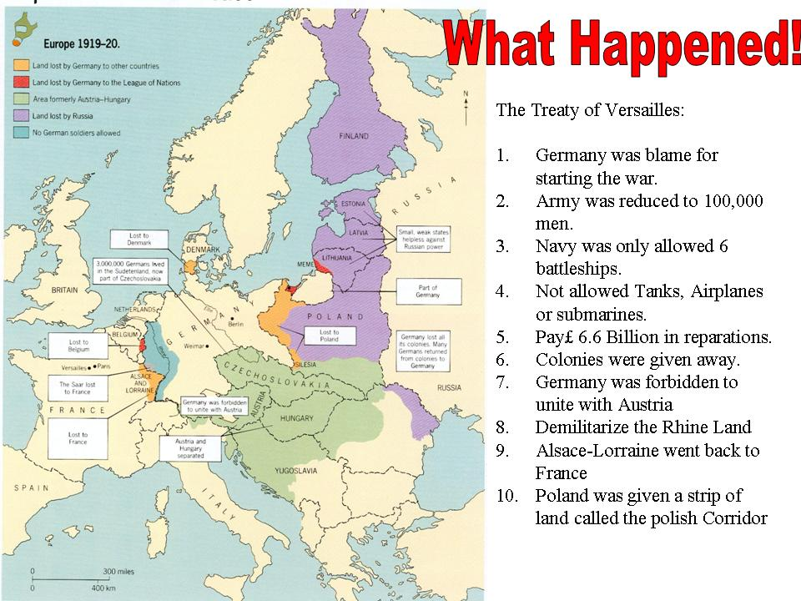
The Versailles Treaty…

Slide 5
In 1919, the only countries viewed as powerful were the United States, France, & Great Britain.
Problems in Post-War Europe:
jobless veterans (unemployment in general, too)
rebuilding ravaged land huge debts owed
spread of radical ideas/birth of
  communism
general dissatisfaction with Treaty
  of Versailles
lack of strong, able European leaders

Slide 6
The League of Nations failed at peace-keeping because:
  No strong leadership (U.S. wasn’t involved)
  No progress in arms reduction
  No way to enforce decisions made (no military presence)

Slide 7
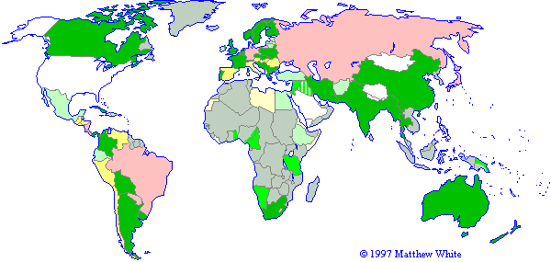
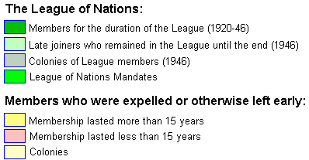
A Weak League of Nations

Slide 8
Actions that ATTEMPTED to signal an
End to All War:
Since the League of Nations was ineffective, nations sought other ways to keep the peace:
In 1925, the treaties of Locarno were signed, which ended all border disputes with Germany
  Took land from Germany and gave it to surrounding countries…made Germany pretty mad.
Kellogg-Briand Pact of 1928 was signed by almost all independent nations.
  Renounced war as an instrument of national policy & limited size of navies.
France built the Maginot Line to protect itself.
  Maginot Line – a fortified line of concrete and bunkers built along the French-German border.

Slide 9
Problems with these ideas:
The Kellogg-Briand Pact could not be monitored or enforced.
The League of Nations was powerless to stop aggressors.

Slide 10
Post War America
As WWI ended, America emerged as the major power in the world.
  Industrially, the U.S. was #1, and Americans’ lives were different than before the war.
The post-war years would hold many changes for Americans of all classes.
Fears of the spread of communism plagued many Americans.
  How did the Palmer Raids play into these fears?
To ensure that minorities still “knew their place” in America, the Ku Klux Klan saw a resurgence in membership.
  Who did they target?

Slide 11
The Red Scare
Palmer Raids – led by Attorney General Mitchell Palmer, these raids looked to arrest leftist communist and anarchist radicals in the United States.
This was a small part of the Red Scare when the fear of communism spread across the United States.
This also led to Nativism. Nativism is a racist ideology that favors native citizens over immigrants. Anti-Semitism is an example.

Slide 12
The Roaring ’20s allowed for lavish parties and changing norms in society. These changes included the following:
  18th Amendment
  Speakeasies
  Flappers
  19th Amendment
October 29, 1929 changed life for everyone.
  What is the significance of that date?
The Great Depression’s effects reached much farther than just the U.S.
  How did it affect European nations?

Slide 13
President Herbert Hoover was blamed for the Great Depression (although he wasn’t the problem), but there were many issues that led to the Great Depression, including:
  Overproduction – making goods in greater amounts than their demand
  Margin Buying- buying a stock partly through your own money and borrowing the rest from brokers ( Brokers could call for their “margin” (money) whenever they wanted. )
  Inflation-a loss in the value of money/currency
  Unemployment
Elected in 1932, Franklin D. Roosevelt attempted to end the Depression (in the U.S.) by implementing social welfare programs and financial security legislation known as the New Deal

Slide 14
France & Great Britain
France and Great Britain had their share of social, political, and economic problems as well.
These problems caused them to ignore many things happening outside of their own countries (ex. Hitler taking Germany and Mussolini taking Italy).
France grew angry with Britain b/c they wanted to ease restrictions on Germany the Treaty of Versailles had put in place.

Slide 15
Totalitarianism in Europe
Totalitarianism-government in which one political party controls all decisions of its people…Dictatorship!
Many totalitarian governments were founded in the midst of the difficult economic times. The first totalitarian government was in the Soviet Union, under the leadership of Josef Stalin.
Stalin’s government in the USSR was based on Communism.
Communism -A form of government in which all wealth and power is owned by the community as a whole.
Stalin’s form transferred ownership to the Communist Party instead of the community.

Slide 16
The Rise of Mussolini
Italian nationalists were outraged by the Paris peace treaties.
The Russian Revolution inspired Italians to take matters into their own hands.
Returning veterans faced unemployment.
Trade declined and taxes rose.
Disagreements within the government made it very weak and ripe for change.
By 1925, Benito Mussolini had assumed the title Il Duce, “the leader” .
In theory, Italy remained a parliamentary monarchy, but it, in fact, became a dictatorship upheld by terror (through the use of intimidation) and propaganda (incl. use of schools).

Slide 17



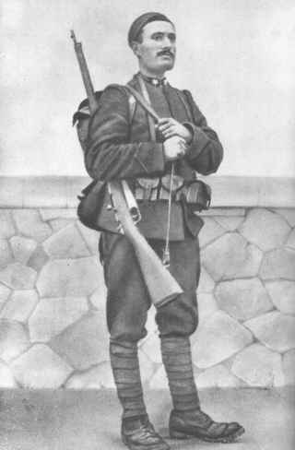
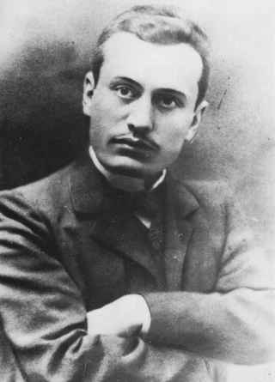
Benito Mussolini

Slide 18
What Is Fascism?
In the 1920s and 1930s, fascism meant different things in different countries.
All forms of fascism, however, shared some basic features:
1. Extreme nationalism
2. Glorification of action, violence, discipline, and , above all, blind loyalty to the state
3. Rejection of Enlightenment faith in reason and the concepts of equality and liberty
Rejection of democratic ideas
Pursuit of aggressive foreign expansion
Glorification of warfare as a necessary and noble struggle for survival

Slide 19
Mussolini’s Promise to the people of Italy…
**He vowed to once again make the Mediterranean another Italian lake.
Fascism appealed to so many Italians because it was seen as powerful and confident during times of disorder and despair.
  Men were to be strong, selfless, and ruthless warriors for the glory of Italy.
  Women were to leave the workplace and return home to rear their children…having 14 or more children earned the woman a medal!
  However, the real strength lay in…

Slide 20
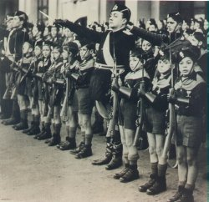
SHAPING THE YOUNG WAS A MAJOR FASCIST GOAL.
FASCIST YOUTH GROUPS:
TOUGHENED CHILDREN
TAUGHT THEM TO OBEY STRICT MILITARY DISCIPLINE
YOUTH GROUPS LEARNED ABOUT THE GLORIES OF ANCIENT ROME
YOUTH GROUPS MARCHED IN TORCHLIGHT PARADES, SINGING PATRIOTIC HYMNS
YOUTH GROUPS CHANTED, “MUSSOLINI IS ALWAYS RIGHT!”
Mussolini’s Youth

Slide 21
FASCISM COMPARED TO COMMUNISM
DIFFERENCES:
  COMMUNISTS
HOPED FOR INTERNATIONAL CHANGE
SUPPORT AMONG URBAN AND AGRICULTURAL WORKERS
  FASCIST
PURSUED NATIONALIST GOALS
SUPPORT FROM BUSINESS LEADERS, WEALTHY LAND OWNERS AND LOWER MIDDLE CLASS
COMMON:
FLOURISHED DURNG ECONOMIC HARD TIMES BY EXTREME PROGRAMS OF SOCIAL CHANGE
IMPOSED TOTALITARIANS GOVERNMENTS IN ORDER TO BRING ABOUT SOCIAL REVOLUTION.
A PARTY ELITE CLAIMED TO RULE IN THE NAME OF THE NATIONAL INTEREST
***FASCISTS WERE ENEMIES OF SOCIALISTS AND COMMUNISTS.

Slide 22
Sec. 4 The Weimar Republic
In 1919, German leaders set up a democratic government known as the Weimar Republic. (following WWI)
The republic faced severe problems from the start:
The government was weak because Germany had many parties
The government came under constant fire from both the left and the right.
Germans of all classes blamed the Weimar Republic for the hated Versailles treaty.
4. When Germany fell behind in reparations payments, France occupied the coal-rich Ruhr Valley.
5. Runaway inflation spread misery and despair

Slide 23
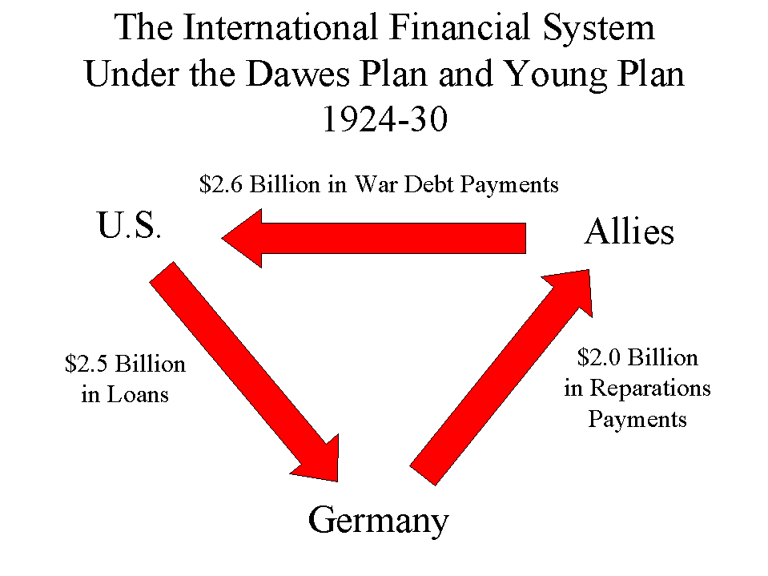
The Dawes Plan (1924)

Slide 24
Adolf Hitler’s Rise to Power
Hitler fought in the German army in WWI.
In 1919, he joined a small group of right-wing extremists.
Within a year, he was the leader of the National Socialist German Workers, or Nazi, party.
In 1923, he made a failed attempt to seize power in Munich. He was imprisoned for treason.

Slide 25
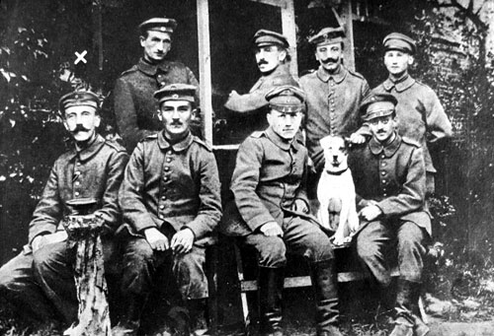
Hitler as a Soldier in WWI

Slide 26
Hitler’s Rise to Power (cont.)
In prison, Hitler wrote Mein Kampf (“My Struggle”).
  Significance: It outlined his plan to create a the third German empire
  It would later become the basic book of Nazi goals and ideology.
Nazi membership grew to almost a million.
In 1933, Hitler was made chancellor of Germany.
Within a year, Hitler was master of Germany. He made Germany a one party state and purged his own party.

Slide 27
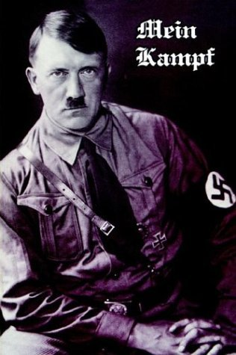
Mein Kampf
[My Struggle]

Slide 28
How the Great Depression Helped Hitler?
Hitler found followers among veterans and lower middle class Germans who were frustrated about their future.
The Great Depression helped Hitler rise to power.
The depression led to widespread unemployment, and misery.
Hitler promised to:
  End reparation payments
  Created jobs
  Restore German greatness
  Rearm Germany and defy the Versailles Treaty
As unemployment rose, Nazi membership grew to almost a million.

Slide 29
The Third Reich (Empire)
Political Policies
Hitler repudiated, or rejected, the hated Treaty of Versailles.
Hitler organized a system of terror, repression, and totalitarian rule.
HITLER’S SECRET POLICE FORCE IN GERMANY WAS CALLED THE GESTAPO.
Social Policies
The Nazis indoctrinated young people with their ideology.
Hitler spread his message of racism.
The Nazis sought to limit women’s roles

Slide 30
Economic Policies
Hitler launched a large public works program.
Hitler began to rearm Germany, in violation of the Versailles Treaty.
Cultural Policies
School courses and textbooks were written to reflect Nazi racial views.
The Nazis sought to purge, or purify, German culture.
Hitler sought to replace religion with his racial creed.

Slide 31
Purging German Culture
Nazis used education as a propaganda tool.
School courses and textbooks were rewritten to reflect Nazi racial views.
The Arts
The Nazis set out to purge or purify German culture. They denounced modern art, saying it was corrupted by Jewish influences.
They condemned Jazz because of its African roots.
They glorified old German myths such as those recreated in operas by Richard Wagner.
At huge public bonfires, Nazis burned books.

Slide 32
Nazism and the Churches
Hitler despised Christianity as “weak “ and “flabby”.
He replaced religion with his racial creed.
In order to control churches, the Nazis combined all Protestant sects into a single state church.
Bibles were removed from altars and replaced with Mein Kampf.
Catholic clergy were silenced and Catholic schools were closed.

Slide 33
Hitler’s Campaign Against the Jews
Hitler set out to drive Jews from Germany.
In 1935, the Nuremberg Laws placed severe restrictions on Jews.
1. Jews were forbidden from marrying non-Jews.
2. Jews were forbidden from attending or teaching at German schools or universities
3. Jews were forbidden from holding govt. jobs
4. Jews were forbidden from practicing law or medicine
5. Jews were forbidden from publishing books.
Many German Jews fled Germany and sought refuge in other countries.

Slide 34
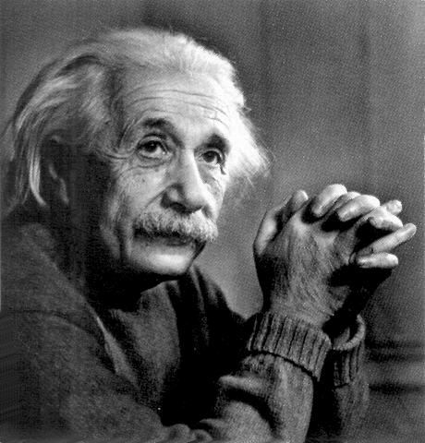
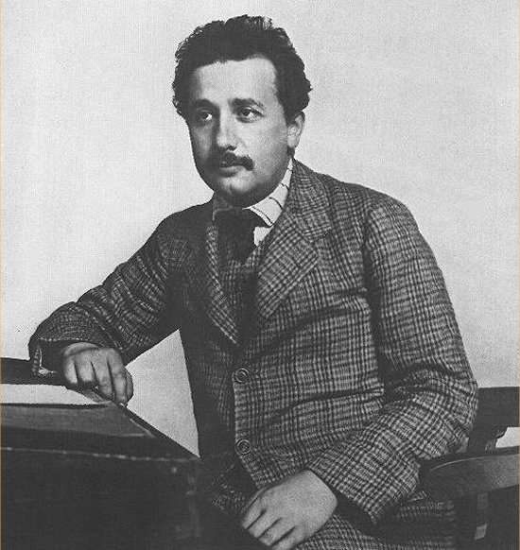

Slide 35
In 1938, Nazi-led mobs attacked Jewish communities all over Germany in what came to be called Kristallnacht, or the “Night of Broken Glass.”
Hitler sent tens of thousands of Jews to concentration camps, detention centers for civilians considered enemies of the state.
Hitler planned the “final solution” – the extermination of all Jews.

Slide 36
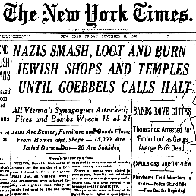
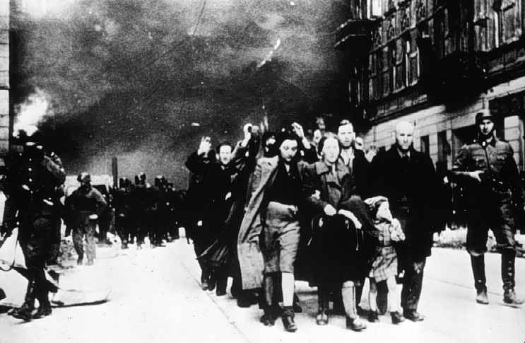
NIGHT OF BROKEN GLASS

Slide 37
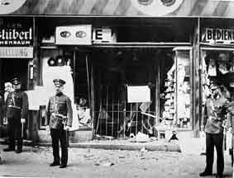
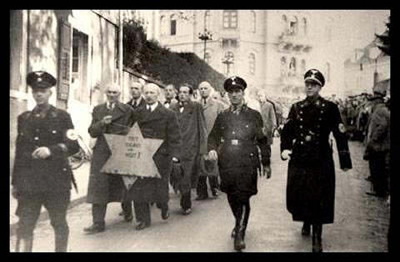
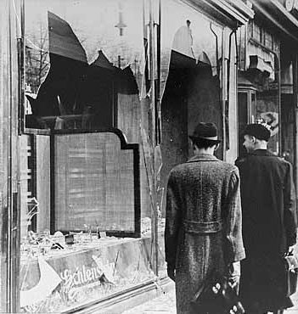
Jews are taken to concentration camps

Slide 38
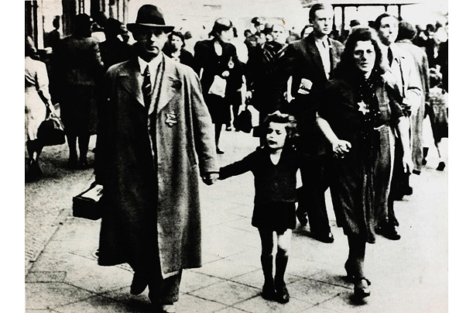

Slide 39
Hitler’s Future Vision of Germany
1. He was going to create the Third German Reich
2. Germans would be a master race of blond haired, blue-eyed people
3. His empire would last a thousand years
**Hitler took the title Der Fuhrer which means the leader.

Slide 40
Nationalism in the East
During World War I, the Ottoman Empire had fought along side Germany.
During the war, the Empire became weak and collapsed.
Kemal Ataturk became the leader of the new country known as Turkey.

Slide 41
Kemal Mustafa “Ataturk”
Kemal attempted to modernize Turkey by bringing in industry and establishing a public education system.
He also wanted to do away with the caliphate (office of the supreme Muslim leader).
As a result, Turkey remains one of the least influenced countries in the Middle East by Islam.

Slide 42
Iran
While Kemal Ataturk was fighting in Turkey, Reza Shah Pahlavi was fighting in Iran.
Similar to Ataturk, Pahlavi wanted to modernize Iran. However, he did not attempt to destroy the caliphate as Ataturk did.
During World War II, the shah sided with Adolf Hitler and the United States and Great Britain invaded to overthrow him.

Slide 43
Saudi Arabia
In the early 1920’s, Ibn Saud united Arabs to create the nation of Saudi Arabia on the Arabian Peninsula.
Although it started off poor, the country soon discovered it had one of the largest oil reserves in the world, making it one of the richest countries.
However, not everyone benefits as Saudi Arabia is one of the last true monarchies and is ruled under Sharia law.

Slide 44
Balfour Declaration
Palestine had been the home of the Jews in antiquity.
However, the region was not made up of 80% Muslims.
The Zionist movement called for the creation of a new Jewish homeland.
In an attempt to gain support from the Jewish population in World War I, the Balfour Declaration was issued. It stated that the Jews should have a homeland in or near Palestine.

Slide 45
Indian Independence
Mohandis Ghandi used Civil Disobedience (intentionally breaking the law to prove that it is unjust) to attempt to break away from British Rule.

