Slide 1
UNITED STATES HISTORY
LYNDON JOHNSON, VIETNAM, and
RICHARD NIXON

Slide 2
3THE GREAT SOCIETY
After Kennedy assassinated Vice President Lyndon Johnson (LBJ) became president. He continued JFK's goals.
LBJ's Domestic Goals gain Democratic voters by helping the poor with tax supported government programs.
LBJ, like JFK will focus on:
1A Economic Opportunity Act (EOA) Anti-Poverty legislation that created:Head Start- pre-K to poor
VISTA (Volunteers in Service to America)-for US service volunteers
Job Corps-job training
1B Civil Rights Act of 1964 prohibited discrimination based on race, religion, national origin, and sex

Slide 3
2. President Johnson will declared “unconditional war on poverty in America”
3. President Johnson's plan for America was called the "Great Society"
4 Great Society programs included:
a. Medicare Act- Created tax supported health insurance for the aged (Medicare), and poor (Medicaid)
b. Voting Rights Act 1965- ended literacy tests to vote; federal monitoring voter registration
c. 24th Amendment- abolished the poll tax
d. Department of Housing and Urban Development (HUD)- tax supported affordable housing
e. Immigration Act 1964- ended nationality based immigration quotas
f. Civil Rights Act of 1968- ended discrimination in housing

Slide 4
The Warren Court Decisions
1960s U.S. Supreme Court led by Chief Justice Earl Warren
Mapp v. Ohio- evidence obtained illegally may not be used at trial.
Gideon v. Wainwright-provide attorneys
Escobedo v. Illinois- right to an attorney during questioning.
h. Miranda v. Arizona- read rights before being questioned
Decisions controversial, but all expanded the rights of the accused.
5. Johnson’s Great Society is often compared to Progressive Movement programs and Roosevelt’s New Deal as all :
provided tax supported funds
made the government a bigger part of citizen's lives.
increase government spending & debt.

Slide 5
WORLD MAP

Slide 6
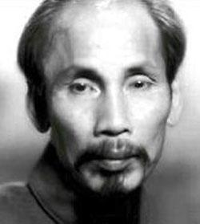
MOVING TOWARD CONFLICT
Vietnam background info:
France controlled Vietnam before WWII
Japan controlled it during WWII
Vietminh (Vietnamese Communists) led by Ho Chi Minh led the resistance against France after WWII
1954 at Dien Bien Phu-Vietminh beat the French
When the French left Vietnam, Eisenhower feared the domino theory- if one nation falls to Communism, they all fall.
Geneva Accords in 1954:divided communist North Vietnam (lead by Ho Chi Minh) and Nationalist south (led by Ngo Dinh Diem) on the 17th parallel.

Slide 7
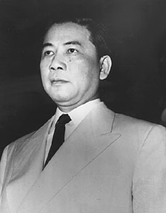
US Goal: contain communism.
7. Vietcong- South Vietnamese communistslwanted communism.
8. Diem (corrupt) led South Vietnam .Refused unifying elections 1956. US assassinated.
9. 1964, North Vietnam boat shot at a US naval ship in the Gulf of Tonkin.
10. Tonkin Gulf Resolution- Congress GAVE Pres. Johnson military powers to wage war in Vietnam. The U.S. escalation troops .
RIP

Slide 8
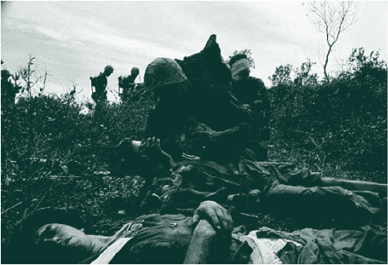
U.S. Troops in Vietnam
Escalation
Jan. 1965 – 20,000
Dec.1965 – 200,000
Jan. 1968 – 540,000
Notes:
This slide displays the increase of U.S. combat troops sent to South Vietnam and America’s policy of escalation.

Slide 9
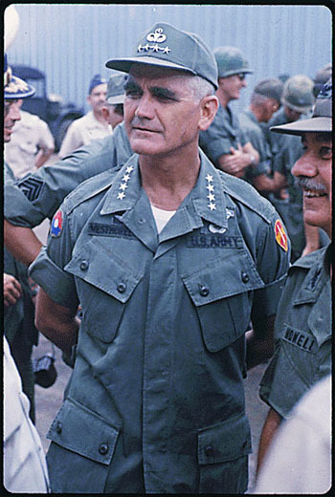
U.S. INVOLVEMENT AND ESCALATION
11. General William Westmoreland led US troops, and continued to request more troops
North Vietnamese (Vietminh) and Viet Cong (South Vietnamese communists) were impossible to defeat as they were elusive, hard to find. VC blend in with civilians and attacked and escaped in tunnels
Ho Chi Minh Trail- ran through neighboring Laos and Cambodia enemy used to run supplies and troops

Slide 10
VIETNAM

Slide 11
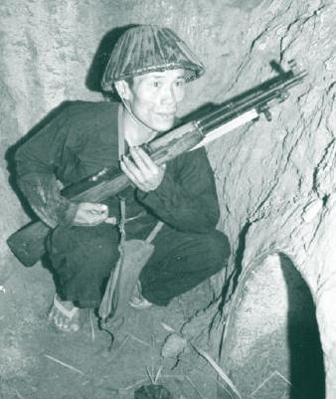
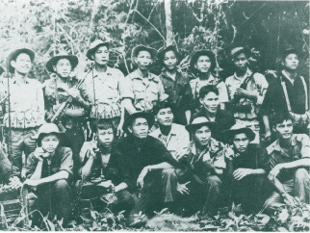
Vietnam Battle Tactics
Disguised themselves as locals
Don’t face Americans on battlefield
Retreat to tunnels
125 miles of tunnels in 1965
Landmines and booby traps
Notes:
American soldiers quickly learned that this was a different type of war. The U.S. was prepared to fight a war similar to the Korean War, but Vietnam provided numerous challenging obstacles. The Viet Cong would infiltrate villages and dress like the people living there. American troops struggled with what the enemy looked like and where to find them. The enemy could be an elderly lady in a remote village that might shoot at Americans. The Viet Cong could also retreat to miles of caves and tunnels after coming out to fight the Americans. These tactics, and more, were difficult to overcome.

Slide 12
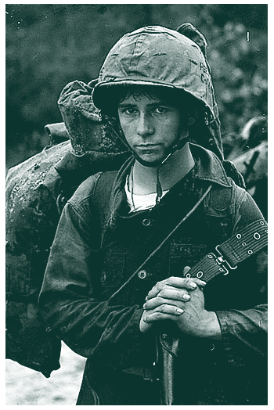
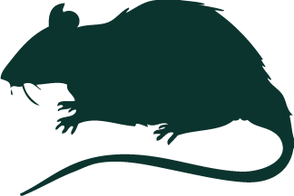
Tunnel Rats
Small American soldiers
Crawled into tunnels to fight Viet Cong
Tunnels were booby trapped
Played a valuable role in the war
Notes:
The United States responded to tunnel retreats by the Viet Cong by sending smaller American soldiers into the tunnels to blow up or flush out the enemy. These soldiers became known as Tunnel Rats. Besides putting themselves in harm’s way with the Viet Cong, they also encountered rats, snakes, scorpions, and booby traps in the tunnels.

Slide 13
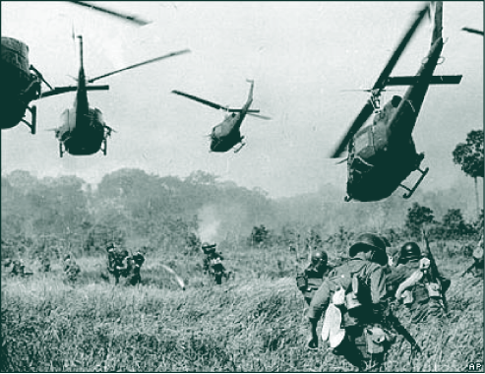
Credibility gap- People no longer trusted the government because LBJ reported that US was winning war but TV showed differently. TV media-Played a key role reporting the truth to American people.
Vietnam conflict resulted in US inflation (value of the money declines) and a loss of funding for the Great Society programs.
By 1967, the US was split between people supporting the war (Hawks) and those opposing the war (Doves) . Discontent would continue to grow and protests became more common.
Tet Offensive- US watched Vietcong attack 100 cities in South Vietnam 1964 on TV. BAD as LBJ told US told war was about over.
US support drastically declined in ‘64 as we saw we could not win.

Slide 14
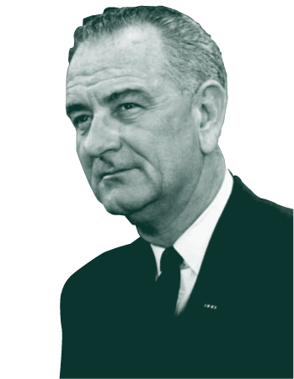
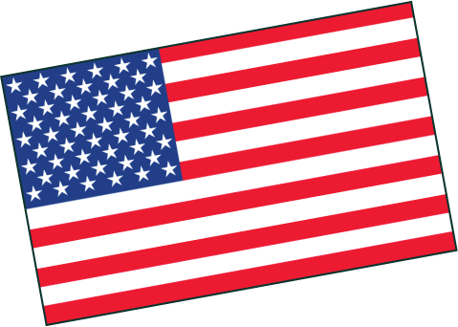
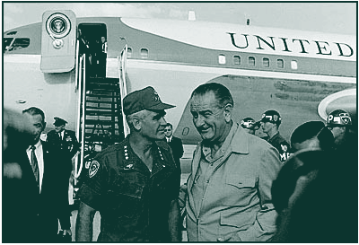
Lyndon B. Johnson
“I will not, I shall not, seek another term as your President.” (March 31, 1968)
Notes:
Greg remembers tuning into LBJ on television and listening to the American leader as he briefed the nation.

Slide 15
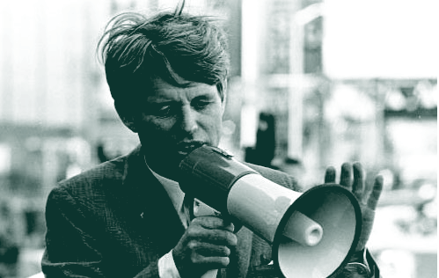
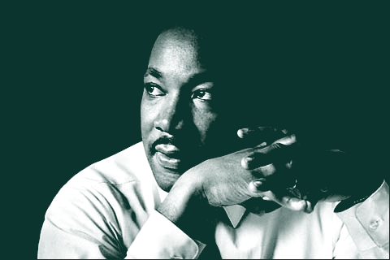
1968 was BAD
MLK Jr. is assassinated LBJ refused to run for re-election
Democratic Presidential Robert F. Kennedy assassinated
Riots (anti-war protests) at Democratic National Convention
Notes:
1968 could be the most turbulent year in United States history. President Johnson became a victim of his own war, Martin Luther King was assassinated in Memphis in April, and Bobby Kennedy, the front-runner for the presidency, was assassinated in Los Angeles in June. Even more turmoil occurred in Chicago in August of 1968 when major riots broke out at the Democratic National Convention.

Slide 16
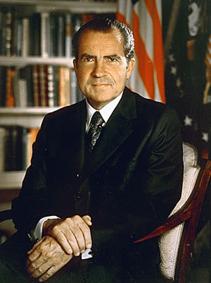
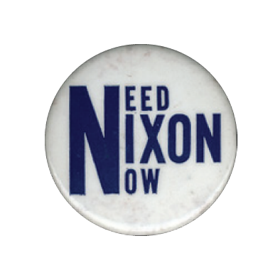
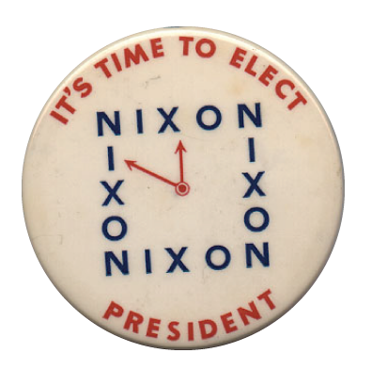
1968 Election
6. Nixon is elected president. Promised “Peace with Honor”
18 year olds could fight, but not vote—led to the 26th Amendment
Notes:
Greg Clevenger could not vote in the 1968 election. Eighteen-year-olds were fighting and dying in Vietnam, but would not be able to legally vote until the 1972 election. Nixon campaigned on the promise that he would get the U.S. out of Vietnam, and there would be “Peace with Honor.”
Critical thinking question: Was it fair that the draft age was 18, but the voting age was 21?

Slide 17
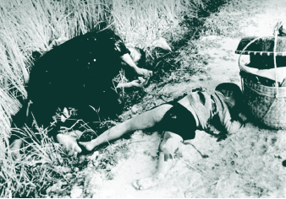
END OF THE WAR AND ITS LEGACY
Richard Nixon pulled troops out of Vietnam, Vietnamization.
South Vietnamese army would take over; US troops withdrawn.
1969 issue sickened the American people and widened the credibility gap. 3A My Lai Massacre US troops killed 350 innocent Vietnamese (women children & elderly). US rioted 3b Nixon invaded Cambodia . Student protests erupted ending in violence and death.
Notes:
A most disturbing event took place in Vietnam on March 16, 1968, at a small village called My Lai. Lt. William Calley was ordered to go to My Lai and find the Viet Cong. American soldiers, very battle weary by this time, opened fire on innocent women, children, and senior citizens, killing 350 civilians in a massacre that lasted several hours. Lt. Calley was later sentenced to 20 years “hard labor” for his role in the My Lai massacre, though he only served three and a half years of house arrest.

Slide 18
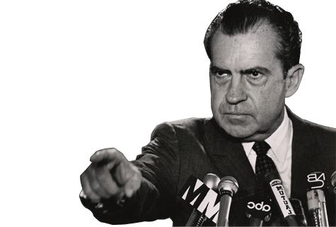
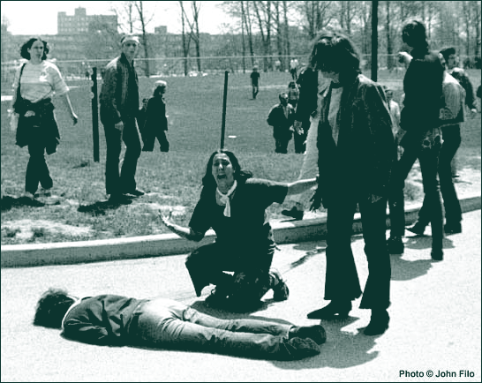
End of the War
Violence and death occurred on the campuses Kent State (Ohio) and Jackson State University in MS. National Guard fired into crowds killing six students.
Pentagon Papers (documents)were published indicating Pres. Johnson planed to enter the war saying he would stay out. Distrust of the government –at all time high. The credibility gap was HUGE!
U.S. removed all troops 1973. Our military involvement in Vietnam had ended.
Click here to play a sample from “Ohio”
Notes:
Kent State University in Ohio became the focus in 1970 when students once again demonstrated against U.S. interventions in Southeast Asia. The Governor of Ohio called in the National Guard to monitor the demonstration. Rocks were thrown when demonstrators were ordered to disperse; shots were fired killing four students and wounding ten. President Nixon had called the protestors “Bums.”
The song that is playing is “Ohio,” by Crosby, Stills, Nash, and Young. It is another protest song and was written directly in response to the shootings at Kent State.

Slide 19
The Vietnam Conflict/War costs: US dead 58,000 .300,000+ wounded. The public’s loss of trust in the government.
War Powers Act 1973-
Within 48 hours of sending troops president must inform Congress
90 day limit for troops to stay without Congress declaring war

Slide 20
THE NIXON ADMINISTRATION
Richard Nixon had won the 1968 presidential election by the slimmest of margins. One method he used to gain support in the South was called the Southern Strategy-
Nixon’s attempt to gain support of conservative southern Democrats by promising to slow integration, as well as appoint a southerner to the Supreme Court.
Once in office, President Nixon was faced with a troubled economy.
1a& 1b Stagflation- high inflation coupled with high unemployment
Heavy dependency on foreign oil- the U.S. received much of its oil from the Middle East from a collection of countries called 1C OPEC- Organization of Petroleum Exporting Countries
Arab OPEC nations cut off oil sales (embargo) to the U.S. in 1973 when we supported Israel against Egypt and Syria in the Yom Kippur War
When they resumed oil sales to us in 1974, oil prices had quadrupled further contributing to our high inflation dilemma

Slide 21
OPEC NATIONS WORLDWIDE

Slide 22
OPEC NATIONS-ARABIAN PENINSULA

Slide 23
To combat the growing problem of inflation, President Nixon will place a 1b freeze on worker’s wages, business prices , and business fees for 90 days. This will ease inflation for a period of time, but did not solve the problem.
Where Nixon had troubles in the economy, his fortune was reversed when it came to foreign policy. Nixon is going to have great success and triumph in this area.
Nixon chose a more flexible approach in dealing with communist nations called 2a détente- Nixon’s flexible policy in dealing with communist nations that focused on a willingness to negotiate to ease Cold War tensions
U.S. and Soviet Union signed the 2b SALT I Treaty (Strategic Arms Limitation Treaty)- five year agreement limiting the number of intercontinental ballistic missiles (ICBMs) and submarine launched missiles
Continued withdrawal of U.S. soldiers from Vietnam

Slide 24
WATERGATE: NIXON’S DOWNFALL
The ultimate downfall of President Richard Nixon will come in the form of a scandal known as Watergate- the Nixon administration’s attempt to cover up a burglary of the Democratic National Committee (DNC) headquarters at the Watergate office and apartment complex in Washington, DC
Two reporters, Bob Woodward and Carl Bernstein, continued to probe into the attempted burglary, as it appeared it was more than just a “burglary”. Eventually the entire scandal exploded into situation that consumed the office of the presidency.
As the situation continued to escalate, more and more incriminating evidence came out against President Nixon and his staff. The final straw was a set of 3 audio tapes Nixon had with conversations concerning Watergate. Nixon recorded things in his office to help with his future memoirs. (????)

Slide 25
With overwhelming evidence against the President, Congress approved three articles of impeachment. On August 8, 1974, before the full house could vote on his impeachment, 4 President Nixon resigned his office. 2 Gerald Ford was then sworn in as the 38th President of the United States.
Eventually, 25 members of Nixon’s staff will serve jail time for their involvement in the Watergate scandal/cover-up. The biggest impact of Watergate, however, was that the 5 American public lost even more respect and trust in our elected officials and government.

