Slide 1
UNITED STATES HISTORY Unit 6 (CHAPTER 10)
The Roaring Twenties: The Clash of Traditionalism and Modernism

Slide 2
CHANGING WAYS OF LIFE
The biggest concern of most Americans following WWI was staying out of future world conflicts
This concept led to the rebirth of the following:
#1 Isolationism- pulling away from world affairs
People feared #2 communism as their goal was to end private ownership of business and property.
Anti-immigration activity:
#3 Nativism- prejudice against foreign-born people Americans were scared that immigrants were bringing radical ideas into the country.
#4“Red Scare”- Fear of Communism

Slide 3
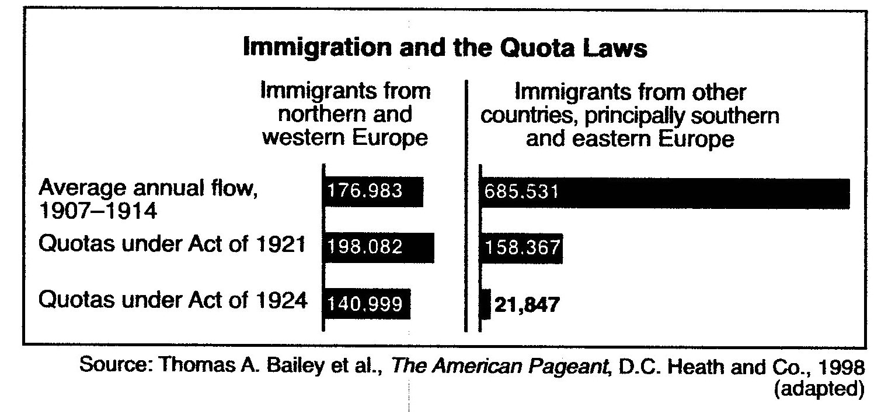
What is the main idea?

Slide 4
HEY YOU! This is on the test. . .
Isolationism Americans wanted no wars so they a_________ other nation’s affairs.
Red Scare: U.S deported aliens (foreigners) thought to be c______________: (Workers own business) KKK: immigrants threaten American life.
Chinese Exclusion Act in 1882-US fearful of C___________ customs

Slide 5
“RED SCARE” POLITICAL CARTOONS

Slide 6
#5 Sacco and Vanzetti-an immigrants who were charged with murder. However, many people believed they were innocent and were arrested and executed because of their radical political beliefs.
Bartolomeo Vanzetti’s Last Statement. “We [Sacco and Vanzetti] were tried during a time that has now passed into history…a time when there was a hysteria of resentment and hate against the people of our principles, against the foreigner, against slackers…”

Slide 7
What is the main idea below?
#6 Ku Klux Klan- (KKK) there primary target were not just black Americans but immigrants, Jews, Catholics, and “modern” women. They targeted anybody that they believed went against “traditional American values.”

Slide 8
#7 Emergency Quota Act (1921) restricted the number of immigrants that could enter the country each year.
Emergency Quota Act | National Origins Act of 1924 | Hispanic Immigration
Signed by President Harding in 1921. | Made immigrant restriction a permanent policy. | First wave of Mexican immigration followed Newlands Reclamation Act of 1902.
Established a temporary quota system. | Tightened the quota system to 2 percent of those already in the United States. | Newlands Act provided funds for irrigation and farm projects in the American Southwest.
Only 3 percent of the total number of people in any ethnic group already in the United States could be admitted in a single year. | Eventually limited immigrants to 150,000 per year. | By 1914, more than 70,000 Mexican immigrants had come to the United States due to the Mexican Revolution and job opportunities available in the United States.

Slide 10
After World War I, many people rejected the ideas of the #8 Progressives when government had attempted to regulate businesses and help the people. Instead, the country returned to a much more business friendly environment.
This was seen as business owners and workers clashed. Many #9 Labor Unions went on strike after the war demanding higher wages and better working conditions.
However, most Americans supported the business owners as labor unions had many immigrants and were increasingly associated with communism.

Slide 11
Management used the “Red Scare” to their advantage during all these strikes.
They began labeling striking workers as communists.
They claimed the striking workers were attempting to establish communism by striking.
The 1920s was a set back for labor movements and unions:
Unions became association with communism.
Large immigrant work force was willing to work for less money.
Furthermore, after the war many of the business regulations of the progressive era went away and #10 tariff went back up.
The most famous tariff of the time period was the #11 Fordney-McCumber tariff passed in 1922.

Slide 12
HEY YOU! This is on the test. . .
Labor unions developed need to improved w_______ conditions.
In the 1920s people feared labor unions linked to c____________. (Workers own business)
After World War I labor strikes i___________ because pay was l_________ than the price of living.

Slide 13
ANALYZE THE FOLLOWING CARTOON:

Slide 14
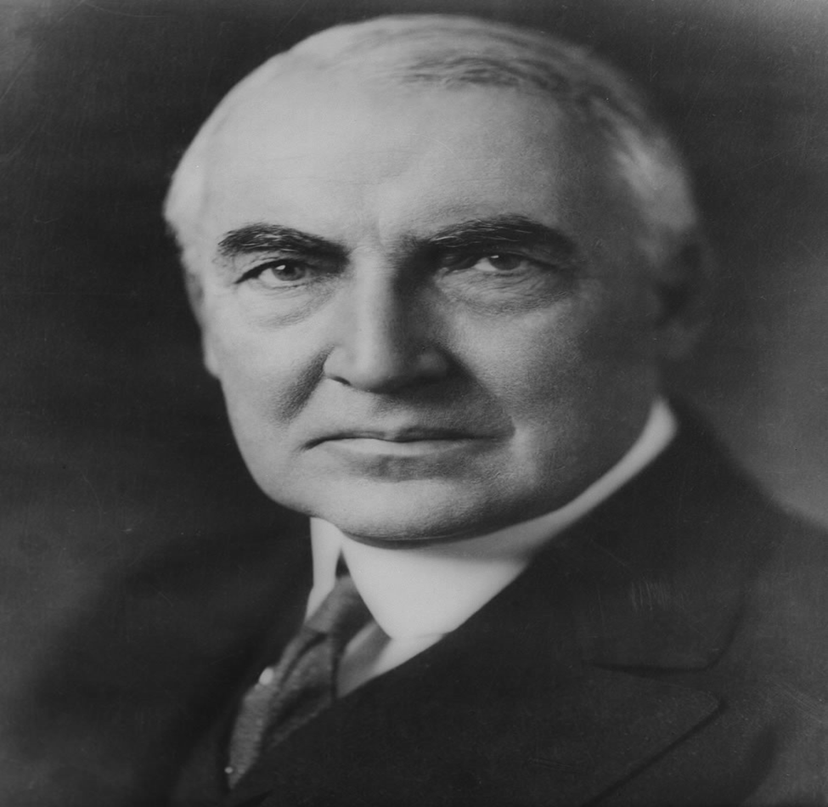
President Warren Harding 1920

Slide 15
THE HARDING PRESIDENCY
These policies of the 1920’s were most clearly embodied in the presidency of #12 Harding & Coolidge
He promised a #13 Return to Normalcy He rejected the progressive policies of Roosevelt, Taft, and Wilson, and instead called for the government to become less involved in business and the peoples’ lives.
Although many people embraced Harding’s call for normalcy and he was very popular, his presidency quickly became full of scandal and corruption.

Slide 16
Harding’s first mistake was that he appointed his friends to his Cabinet. They were known as the #14 Ohio Gang and took advantage of their position in the government to make lots of money. This caused much scandal in Washington.
Most famously, Harding’s Secretary of the Interior gave oil rich public land in Teapot Dome, Wyoming, to oil companies. In exchange, he received many gifts and lots of money. This became known as the. #15 Teapot Dome Scandal

Slide 17
President Calvin Coolidge

Slide 18
PRES. CALVIN COOLIDGE: THE BUSINESS OF AMERICA
This scandal might have brought the Harding administration down except for the fact the Harding died suddenly in 1923 and was replaced by his vice president #16 Calvin Coolidge
Calvin Coolidge restored Americans’ trust in the government and cleared up the corruption and scandal of the Harding administration.
He was very pro-business and continued many of the #17 Laissez faire policies of the Harding administration.

Slide 19
What is the main idea?
“[In 1914], Ford announced that he would nearly double the minimum salary paid to his 13,600 workers to $5 a day, and reduce the workday from nine hours to eight. In a stroke, he transformed the people who manufacture automobiles into the people who buy them. …The reaction from business thinkers was generally negative. ‘He’s crazy, isn’t he?’ asked Adolph Ochs, publisher of the New York Times. …The Wall Street Journal went ever further, accusing Ford of having ‘committed economic blunders, if not crimes’ and applying ‘spiritual principles where they don’t belong.’” --Kevin Baker, “Ford’s Paradox,” 2000

Slide 20
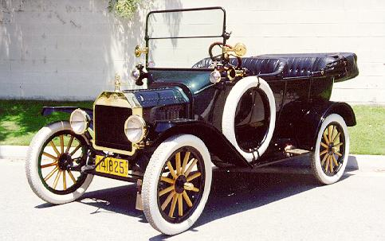
HEY YOU! This is on the test. . .
Republicans of the 1920s (think Calvin Coolidge -“The business of America is b___________”) wanted laissez-f_______ economics.
Harding was involved in government s________.

Slide 21
Economic Prosperity
The 1920’s was a time of economic prosperity. People were making more money. Business was booming.
There was also an increasing disparity of wealth- rich richer and poor poorer.
This economic prosperity was the result of a few different things:
World War I created an economic boom as the United States supplied the Allies with food and supplies for the war.
The #1 assembly line made factory production much more efficient.

Slide 22
Economic Prosperity
# 2 Henry Ford used assembly line to make his Model-T car. His car factories had high employment. When people have jobs they spend money, and this is good for the economy.
“It is necessary that competition exist if the whole economy is to remain dynamic. When competition ceases to exist, there will be no pressure to pass the benefits to the consumer, nor will there be any reason to introduce new and risky techniques.” Main idea?
Car resulted in #3 Urban Sprawl cities started to spread out. People used #4 Installment Plans to pay by taking out a loan and paying monthly.
Resulted in factories producing more →more jobs →people spending more money → cycle continued. The economy seemed to be booming.

Slide 23
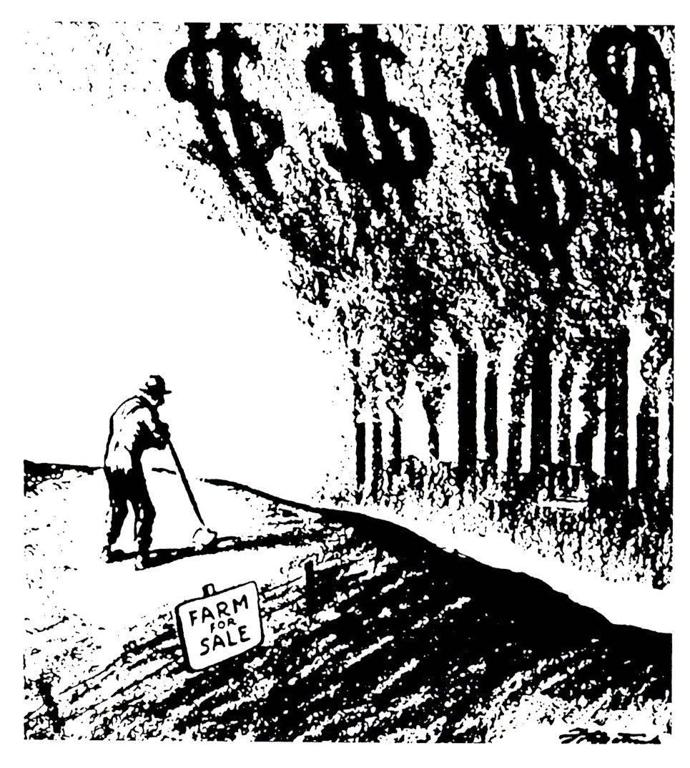
What is the main idea?
Car resulted in #3 Urban Sprawl cities started to spread out. People used #4 Installment Plans to pay by taking out a loan and paying monthly.
Resulted in factories producing more →more jobs →people spending more money → cycle continued. The economy seemed to be booming.

Slide 24
Main Idea?
“We have decided upon and at once put into effect through all the branches of our industries the five day week. Hereafter there will be no more work with us on Saturdays and Sundays. These will be free days, but the men, according to merit, will receive the same pay equivalent as for a full six day week. …It does not pay to put men at work excepting in continuous operations, from midnight until morning. As a part of low cost production—and only low cost production can pay high wages—one must have a big investment in machinery and power plants. Expensive tools cannot remain idle. They ought to work twenty-four hours a day, but here the human element comes in, for although man men like to work all night and have part of their day free, they do not work so well and hence it is not economical, or at least that is our experience, to go through the full twenty-four hours.” -- “Why I Favor Five Days’ Work With Six Days’ Pay”

Slide 25
HEY YOU! This is on the test. . .
Opponents (people against) of laissez-faire thought that that the government should r________ business.
Entrepreneur Henry Ford paid f_____ and had a 5 day week (improve productivity); new ideas.
Assembly line d____ prices resulting in widespread purchase. Automobile invention led to hotels and restaurants.

Slide 26
1920s Advertisements

Slide 27
However, not everyone experienced this economic prosperity. #5 Farmers struggled as crop prices dropped.
Also there were still many Americans working in the cities who were struggling to make enough money to survive. In this aspect, the 1920’s were similar to the Gilded Age.

Slide 28
HEY YOU! This is on the test. . .
The economic boom of the 1920s impacted the r_____ and not average American.
Fordney-McCumber Tariff cause US farmers to not sell o________.
Farmers moved to the c_______ for factory workers.

Slide 29
CHANGING WAYS OF LIFE
“Roaring” 20s- The 1920s were a time of massive economic growth. Businesses and factories were very profitable earning this nickname.
Social Issue: Prohibition: The manufacturing, selling, and transporting of alcohol was legally prohibited
This was put into effect with the passage of the 18th Amendment to the Constitution.
Resulted in the rise of organized crime as people like Al Capone made millions in illegal alcohol sales. Also led to bootleggers and the operation of speakeasies, illegal bars.

Slide 30
1920s GANGSTER
AL CAPONE
ARMORED CAR

Slide 31
CHANGING WAYS OF LIFE
Prohibition
Remember, during the progressive era alcohol had been banned by the #6 18th Amendment
Although it was still the law in the 1920’s, it caused more problems than it solved.
Prohibition led to the rise of #7 Organized Crime as gangs made money off of selling alcohol illegally.

Slide 32
CHANGING WAYS OF LIFE
Also, #8 Speakeasy (illegal bars) showed up all over the cities.
The most famous gangster of the time was #9 Al Capone He was in charge of one of the largest crime organizations in the US.
Because of the rise in crime and problems with enforcing the 18th amendment, it was repealed by the #10 21st Amendment in 1933.
“According to those who supported the measure, it was a noble experiment. But it proved impossible to enforce and consequently increased disrespect for the law.”

Slide 33
Traditional vs. Modernism --- Science vs. Religion
The 1920’s were a time of extraordinary change in the United States. However, many Americans did not like this change and wanted to hold on to traditional values.
This was seen in 1925 in Dayton, Tennessee during the #11 Scopes Monkey Trail
Many Christian Americans rejected the culture of the 1920’s and were #12 Fundamentalist (people who interpret the Bible literally).

Slide 34
What was the main idea?

Slide 35
What was the main idea?
“Our position is that the statute [law] is sufficient. The statute defines exactly what the people of Tennessee decided and intended and did declare unlawful, and it needs no interpretation. The statute speaks of the evolutionary theory, and the statute specifically states that teachers are forbidden to teach in the schools supported by taxation in this State any theory of creation of man that denies the Divine record of man’s creation found in the Bible…” --Prosecutor William Jennings Bryan
“If today you can take a thing like evolution and make it a crime to teach it in the public schools, tomorrow you can make it a crime to teach it in private schools…at the next session you may ban books and the newspapers. Soon you may set Catholic against Protestant, and Protestant against Protestant, and try to foist your own religion upon the minds of men.” --Defense Attorney Clarence Darrow

Slide 36
Traditional vs. Modernism --- Science vs. Religion
Based on this idea, Tennessee passed a law in 1925 that banned the teaching of evolution in public schools.
A young science teacher named #13 John Scopes challenged this law by teaching evolution in a small school in Dayton, Tennessee.
He was arrested and put on trial. Scopes was represented by the American Civil Liberties Union (ACLU), and the fundamentalists were represented by #14 William Jennings Bryan
In the end, Joh Scopes was found guilty and fined $100. Although the court case did not change much, it served to represent the divide in America between modernists and traditionalists.

Slide 37
Analyze the following cartoon:

Slide 38
HEY YOU! This is on the test. . .
Suffrage-the f_____ movement in the early 1900’s.
Flappers challenged t__________ because they wanted freedom in behavior.

Slide 39
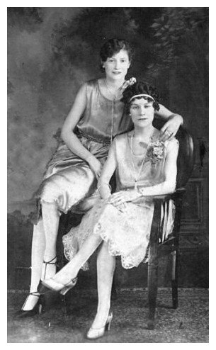

Slide 40
EDUCATION AND POPULAR CULTURE
Social Issue: School enrollment increased dramatically
News coverage expanded with radio, as well as newspaper and magazine more people reading! (Reader’s Digest (1921) and Time (1923)
Charles Lindbergh was the first to fly across the Atlantic
Authors were critical of the 1920s materialism: Sinclair Lewis, F. Scott Fitzgerald. Ernest Hemingway

Slide 41
HEY YOU! This is on the test. . .
Scopes trial 1925 showed the conflict between r_____and science.
Prohibition (18th Amendment) resulted in people not respecting the l____.
Authors (Lewis, Hemingway & Fitzgerald) criticized the conformity and m____________ of the 1920s.

Slide 42
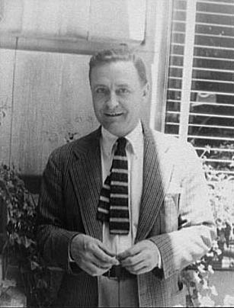
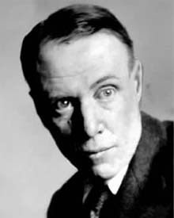
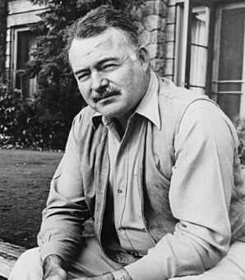
The Lost Generation-Some writers became sour with the materialism in American society, they moved to Paris.
Sinclair Lewis F. Scott Fitzgerald
Ernest Hemingway

Slide 43
THE HARLEM RENAISSANCE
Great Migration- 5 million African-Americans migrated to northern cities for jobs. 1920, 40% of the U.S. African-Americans lived in cities.
Many settled in the New York City borough of Harlem, which had problems- overcrowding, unemployment, and poverty.
Problems overshadowed in the 1920s the #23 Harlem Renaissance- literary and artistic movement celebrating African-American culture.
Harlem Renaissance (writers, poets, artists, musicians, etc…) encouraged a African-Americans to celebrate their culture.
One creative aspect that took off like wildfire throughout Harlem was jazz music. Clubs in Harlem were some of the best in New York City to listen to jazz.

Slide 45
With the growth in population came a renewed discrimination from people in the North. This will lead to the rise of the NAACP (National Association for the Advancement of Colored People).
An influential figure of the time was #24 Marcus Garvey. He promoted African-American business and the idea of returning to Africa to create and build a powerful nation. All this collapsed when he was arrested and convicted of fraud.

Slide 47
HEY YOU! This is on the test. . .
African Americans:
13th-15th Amendments (late 1800s) gave rights to African Americans.
#22 African-Americans moved north (1900s) for the industrial boom. African-Americans and immigrants competed for jobs and housing in cities.
#23 Harlem Renaissance: African-American artistic and literary movement.

