Slide 1
WORLD WAR II

Slide 2
DICTATORS THREATEN WORLD PEACE
Following WWI, many democracies were established in European countries. Over time, these democracies will fall to the hands of ruthless totalitarian rulers. Totalitarianism- government that has complete control over its citizens, individuals have no rights, and the govt. suppresses all opposition.
Totalitarian states were controlled by a dictator. The following were totalitarian nations and their leaders:
Germany: Adolf Hitler
Soviet Union (Russia): Joseph Stalin
Italy: Benito Mussolini
Japan: Hideki Tojo and Emperor Hirohito
Totalitarian governments rose in Europe for two main reasons:
Economic problems that plagued much of the world
Continued anger and resentment over the Treaty of Versailles

Slide 3
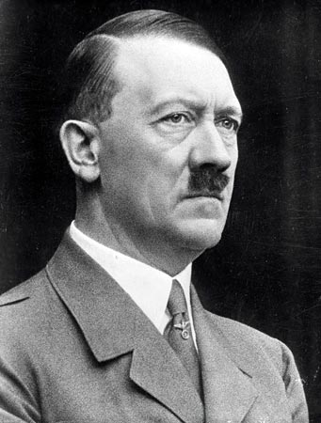
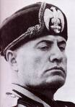
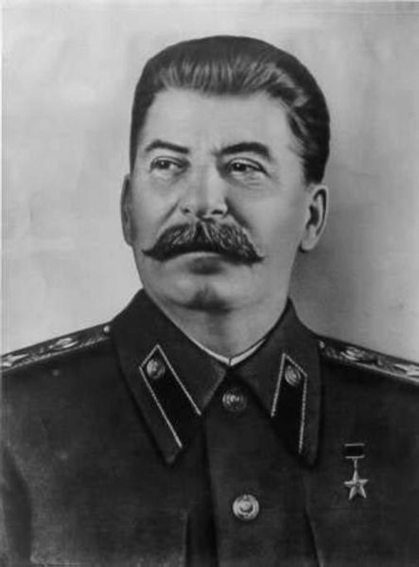
The combatants:
Hitler and Germany were part of the Axis Powers. This was a military alliance between Germany, Italy, and Japan.
They will be against the Allied Powers which consisted of France and Great Britain. Eventually, the Soviet Union and the U.S. will join the Allies.

Slide 4
These totalitarian states, as well as Japan in the Pacific, believed the answer to all their problems was an aggressive conquer and command campaign. Each of these nations developed a plan of conquest in their respective regions.
The U.S. responded to these acts of aggression with extreme caution.
The U.S. and its citizens were not interested in becoming involved in another European or even Pacific conflict.
http://www.history.com/topics/world-war-ii/world-war-ii-history/videos/america-enters-world-war-ii
Continued aggression in Europe and the Sept. 1, 1939, invasion of Poland by Germany brought the start of WWII in Europe.

Slide 5
AMERICA MOVES TOWARD WAR
From the mid 1930’s until our entry into WWII in 1941, President Roosevelt and the U.S. had adopted an interesting foreign policy in regard to European aggression and war. This policy centered around slowly moving away from neutrality to aiding those (Great Britain and the Soviet Union) fighting Nazi Germany.
President Roosevelt had to walk a fine line between helping the Allied nations while maintaining a positive relationship with those Americans supporting isolationism.
Examples of the U.S. aiding G.B. and the U.S.S.R.
Cash and carry policy- warring nations could buy U.S. arms with cash and had to transport them themselves
Destroyers for bases deal- U.S. traded 50 of our old destroyers to G.B. in return for leases on British military bases in Newfoundland and the Caribbean

Slide 6
Lend-Lease Act- the U.S. would lend or lease arms and other war supplies “to any country whose defense was vital to the United States”
http://www.history.com/topics/world-war-ii/world-war-ii-history/videos/drawn-history-the-blitz
The U.S. had essentially become what President Roosevelt called the “arsenal of democracy”. He referred to the U.S. as this b/c we had the means and resources to mass produce the needed war supplies for Great Britain and the Soviet Union.
In late 1941, President Roosevelt and British Prime Minister Winston Churchill met aboard the USS Augusta and agreed upon what became known as the Atlantic Charter- joint declaration of war and post-war aims that pledged the U.S.’s help in every way short of a war declaration.
It was similar to President Wilson’s 14 Points in regard to the establishing an enduring post-war peace.

Slide 7
http://www.history.com/topics/world-war-ii/world-war-ii-history/videos/attack-pearl-harbor
The U.S. will be plunged into full scale war on December 7, 1941. Angry over an oil embargo imposed by the U.S., Japan’s Hideki Tojo launched a surprise attack against the U.S. Pacific fleet at Pearl Harbor, Hawaii.
The Japanese killed over 2,400 Americans and wounded almost 1,200. They also destroyed over 300 aircraft and sunk/damaged 21 ships. Fortunately, Japan’s main targets (3 aircraft carriers) were out to sea and avoided the attack.

Slide 8
PEARL HARBOR, 1941

Slide 12
America’s Response
The next day, President Roosevelt proclaimed Dec. 7th a “day which will live in infamy” and asked Congress for a declaration of war against Japan. They approved the declaration on Dec. 9th.
2 days later, Germany and Italy (Japan’s allies) declared war and the U.S. was now in a two theater (Europe/Pacific) world war.

Slide 13
Practice test Item: #1
What was a major outcome of the Spanish-American War?
A The United States formed a permanent alliance with Spain.
B The United States abandoned the policies of the Monroe Doctrine.
C The United States gained status as a world leader.
D The United States cut defense spending.

Slide 14
Practice Test Items: #2 and #3

Slide 15
MOBILIZING FOR DEFENSE
The U.S. had been supplying Europe with war materials ENDED the Great Depression .
Wartime agencies and projects:
War Production Board (WPB)-
converted factories from peacetime to wartime production
Office of Price Administration (OPA)-
fought wartime inflation setting prices
food rationing
Office of Scientific Research & Development (OSRD)--new inventions
radar, sonar, penicillin, and pesticides such as DDT
Manhattan Project- codename for the U.S. atomic weapons research project conducted for the military

Slide 16
MOBILIZING FOR DEFENSE
Congress passed Selective Training and Service Act (1940) to enlarge military to 15 million.
U.S. minority wartime contributions:
Women- Work in factories. Vital ; also served in non-combat jobs as nurses, drivers, and pilots.
African, Hispanic, Native, and Asian Americans-
segregated and discrimination
Tuskegee Airmen African-American pilots
worked in factories/industries at home
African-Americans- mass migrated north to cities for jobs.

Slide 17
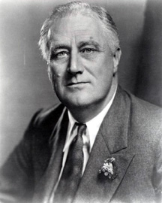
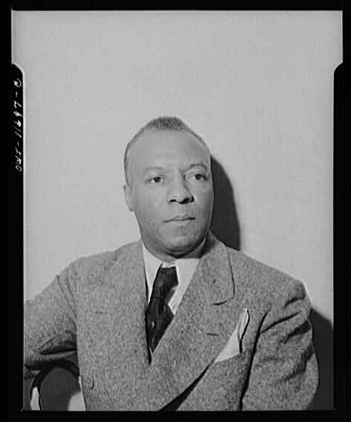
A. Phillip Randolph fought for a Double Victory -against our enemy & segregation
Randolph-planned a protest march on D.C.
President Roosevelt issued an executive order requiring employers to provide equitable work in defense industries regardless of race.

Slide 18
Individual Freedom Restricted In War
Japanese-Americans- Widespread fear of Japanese from coast to coast.
U.S. govt. placed Japanese-Americans in internment, or relocation camps..
Korematsu v. U.S.- U.S. Supreme Court: govt. justified Japanese Internment. During war times national security was a priority over individual Korematsu v. U.S.
What previous U.S. Supreme Court decision did this mirror?

Slide 21
Practice Test Items

Slide 22
Practice Test Item: # 5

Slide 23
Practice Test Items

Slide 24
The War in Europe
“Operation Overlord”. D-Day June 6, 1944
Allied invasion of Nazi-controlled Europe (France).
Largest land-sea-air operation: Three million Allies invaded Nazi controlled France.
Now the Allies had a Western front against Nazi Germany.

Slide 25
Battle of the Bulge Hitler’s last offensive December, 1944.
Yalta Conference- Allies meet to discuss plans after Germany’s defeat. Stalin agreed to:
Help in the Pacific Allow free elections in Eastern Europe
Create an international peace keeping body, the United Nations

Slide 26
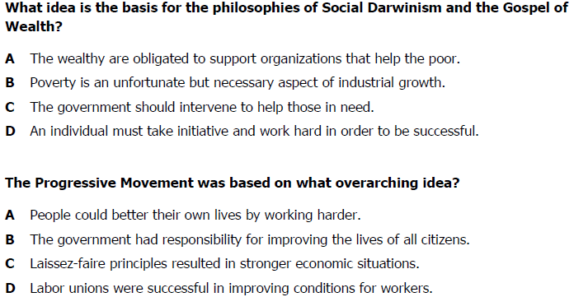

Slide 27
Practice Test Item: # 4

Slide 28
THE HOLOCAUST
Allies discovered German atrocities.
Hitler’s Final Solution a was the genocide- the deliberate and systematic killing of an entire population of the Jews
concentration camps-
work camps and/or executed.
Bodies cremated or buried in mass graves.
Nazis killed six million Jews

Slide 29
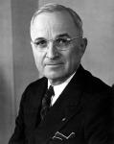
VE Day-Victory in Europe Day-, May 8, 1945 Germany’s surrender.
Sadly, President Roosevelt died of a stroke in April. His VP, Harry Truman, became our nation’s 33rd president.

Slide 30
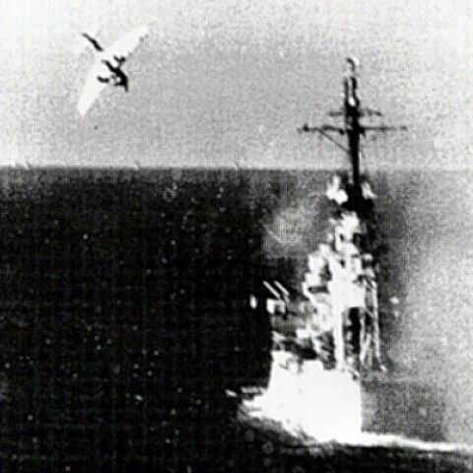
THE WAR IN THE PACIFIC
Midway Island June 1942, U.S. stopped Japanese advancement in the Pacific.
US strategy: island hopping- capturing some Japanese held island; bypassing others to set up bases to eventually attack Japan.
As we got near Japan, Kamikaze pilots attacked US ships.

Slide 31
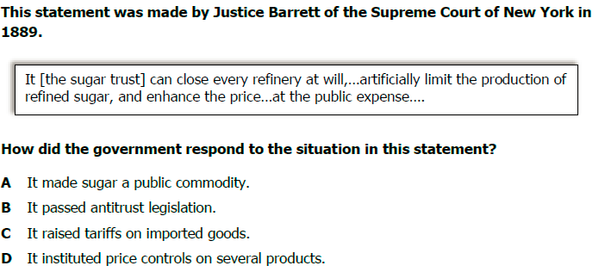
Practice Test Items

Slide 32
Practice Test Items: #6 & #7

Slide 33
Practice Test Items: #8 & #9

Slide 34
President Truman had to decide to invade Japan or use our atomic weapons. There were pros and cons to each:
Invasion
+ keep atomic weapons a secret
- cost a million American lives
Atomic weapons
+spare American lives; end the war
-inflict horrific damage on Japan
President Truman dropped atomic bombs.
August 6, 1945, the city of Hiroshima & Nagasaki.
Emperor Hirohito- surrendered to the U.S.
Victory in Japan (VJ Day) September 1945, Japan surrendered; WWII ended.

Slide 36
Legacies of the war:
United Nations -new peace keeping organization created
US suffered very little physical damage from both WWI and WWII.
GI Bill of Rights- government provide returning soldiers educational and economic opportunities.
taxpayer supported higher education
Provided low interest loans (for homes, farms or businesses)

