Slide 1
UNITED STATES HISTORY Unit 9
THE COLD WAR AND AMERICA’S POSTWAR BOOM

Slide 2
Cold War in Europe
Cold War - a battle of ideologies between the United States (Capitalist and Democracy) and the Soviet Union (Communist and Authoritarian) that took place between 1945 and 1991. Although fighting did take place in different parts of the world, the United States and Soviet Union never directly fought each other.

Slide 3
Origin of the Cold War
As World War II came to an end, the Allies met to decide what would happen in Europe after the war.
At the (1) Yalta Conference Joseph Stalin promised FDR and Churchill that he would return power to the Eastern European countries he had taken from Hitler and allow free elections.
However, later that year at the (2) Potsdam Conference Stalin went back on his word and maintained control of these countries.

Slide 4
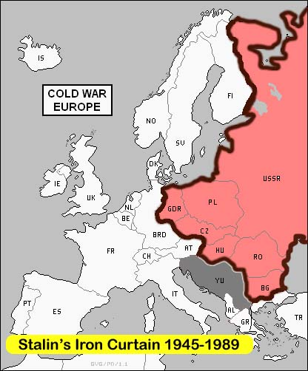
“An iron curtain has descended across the Continent. Behind that line lie eastern Europe. All these famous cities lie in the Soviet sphere, and all are subject to Soviet influence, but to very high control from Moscow.”
--Winston Churchill “Iron Curtain speech”

Slide 5
Origin of the Cold War
However, later that year at the (2) Potsdam Conference Stalin went back on his word and maintained control of these countries.
These countries became known as (3) Satellite Nations (nations that are strongly influenced by the Soviet Union), and they all became communist.
Winston Churchill, the leader of Great Britain during World War II, warned the United States about this divide between communism and democracy in Europe and called it an (4) Iron Curtain that separated Western Europe from Eastern Europe.

Slide 6
Soviets domination Eastern Europe after World War II as they had military forces in Eastern Europe as a result of World War II.
Created satellite nations- countries dominated by USSR; communistic
Churchill described Europe after World War II as being separated by an “Iron Curtain”

Slide 7
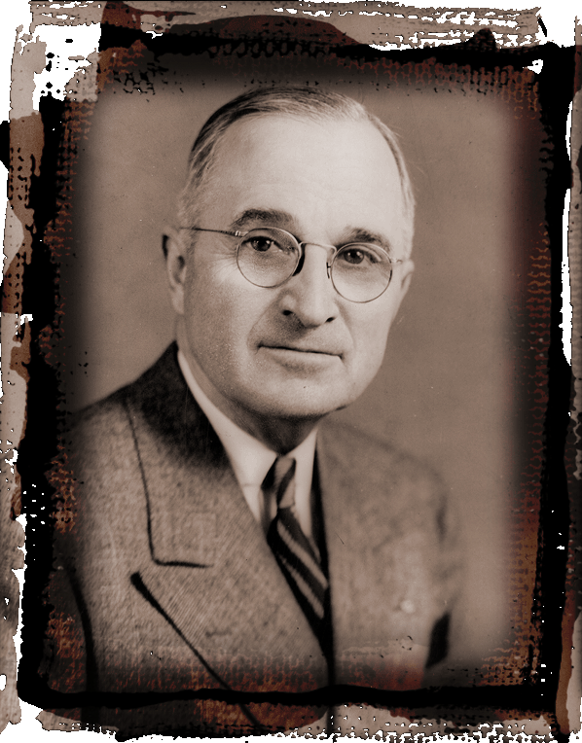
Containment Policy: Greece & Turkey
Truman Doctrine, 1947
In 1946 President Harry Truman asked Congress to assist Greece so they could remain a democracy.
Congress responded by sending military and $400 million to Turkey and Greece.
Plan to stop spread of communism
Notes:
*
The U.S. believed communism was a dangerous threat to capitalism and did not want it to spread to other nations. George Kennan was a state department expert on the Soviet Union. He believed any plans of Soviet (communist) expansion could be blocked if the U.S. had a containment policy, meaning that the U.S. needed a plan to stop communism from spreading any further. Containment quickly became the cornerstone of American foreign policy after World War II. The policy of containment took on two major dimensions in the early stages of the Cold War.
The Truman Doctrine was the dimension with more of a military appearance. In March of 1947, Truman asked Congress for $400 million to guarantee the freedom of Turkey and Greece, two nations that fought communist aggression.

Slide 8
Containment & the Truman Doctrine
Containment and the Truman Doctrine
Immediately after World War II, a United States diplomat working in the Soviet Union sent a telegram to President Harry Truman warning that the Soviet Union wanted to spread communism all over Europe and the World.
This man suggested a policy of (5) Containment to President Truman. This means that the United States would stop the spread of communism but would not try to take back communist ruled countries from the Soviet Union.
This policy became known as the (6) Containment Policy

Slide 9
Containment Policy
The following is an excerpt from a speech made by President Harry Truman in March, 1947.
…I do not believe that the American wishes to turn a deaf ear to the Greek Government.… a militant minority, was able to create political chaos. Meanwhile, the Greek Government is unable to cope with the situation. The Greek Army needs supplies and equipment. Greece must have assistance if it is to become a self-supporting and self-respecting democracy.…
Notes:
*
The U.S. believed communism was a dangerous threat to capitalism and did not want it to spread to other nations. George Kennan was a state department expert on the Soviet Union. He believed any plans of Soviet (communist) expansion could be blocked if the U.S. had a containment policy, meaning that the U.S. needed a plan to stop communism from spreading any further. Containment quickly became the cornerstone of American foreign policy after World War II. The policy of containment took on two major dimensions in the early stages of the Cold War.
The Truman Doctrine was the dimension with more of a military appearance. In March of 1947, Truman asked Congress for $400 million to guarantee the freedom of Turkey and Greece, two nations that fought communist aggression.

Slide 10
U.S. Financial Aid to Europe
The Truman Doctrine was first enacted in (7)Greece and (8)Turkey. Truman gave these countries money and military aid to fight the communist forces in their countries. It was successful as neither country became communist.
Secretary of State George Marshall (1947) recommend US provide financial support to Europe to limit the appeal of communism US sent $12.5 billion to rebuild Europe with the Marshall Plan(1947) provided security in Europe. United States industry required on stable foreign markets in which to sell its goods

Slide 11
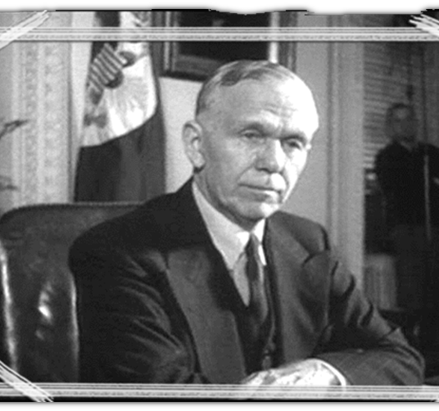
U.S. Financial Aid to Europe
Soon, the United States extended financial aid to all of Europe under the (9) Marshall Plan. The goal was to help re-build Europe after the war and encourage democracy to grow in these countries, not communism. This money was even offered to the Soviet Union and its satellite nations, but Stalin would not accept it.
The Marshall Plan was a huge success in Western Europe and countries like France, Belgium, Great Britain, and West Germany quickly got back on their feet.

Slide 12
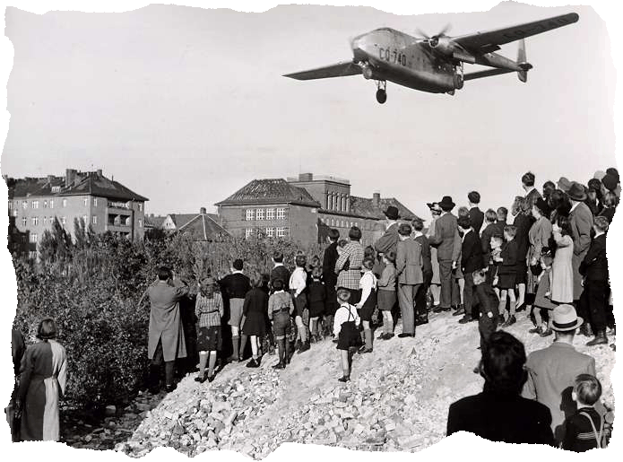
Berlin Blockade
At the end of World War II, the United States, Great Britain, France, and the Soviet Union divided Germany into four sections. They also divided the capital, Berlin, into four sections.
Almost immediately after the war ended, the United States, Great Britain, and France joined their pieces together to form West Germany and the Soviet Union kept their half as East Germany.
.
West Germany was a democracy and East Germany was communist. The same was true for Berlin. However, Berlin was entirely inside of East Germany
Notes:
*
In 1948, the Soviet Union tried to force West Berlin into communism by blocking the shipment of goods into West Berlin. (Remember, the city of Berlin was divided into sections by the victorious nations at the end of World War II. Berlin itself became totally surrounded by communism with only the western section remaining under democratic control.) In order to protect West Berlin from communism, American and British planes transported goods to West Berlin for almost a year, at one point in time landing planes every three minutes. Not wishing to start a war, Soviet leader Joseph Stalin shut down the blockade in May of 1949. This was one of the first confrontations between communism and the West.

Slide 13
Berlin Blockade
Starting in June of 1948, Stalin attempted to take West Berlin by starting the (10) Berlin Blockade. The Soviet Union did not allow any supplies (food, medicine, etc…) to go into West Berlin.
Dedicated to the policy of containment, the United States wanted to keep West Berlin from becoming communist, but they also did not want to start a war.
As a result, they developed an idea for the (11)Berlin Airlift. For almost an entire year, the United States and other Western European countries flew supplies into West Berlin.
After a year, Stalin and the Soviet Union gave up and allowed West Berlin to remain a democracy. This was a win for Truman and containment.

Slide 14
Collective Security: NATO & Warsaw
As a result of the Berlin Blockade in 1948, the United States saw that Western European nations needed to be protected from Soviet aggression. The United Nations could not provide this protection because the Soviet Union was a part of the United Nations and had a veto vote.
Therefore, in 1949 the United States and 11 other countries formed (12)North America Treaty Organization. This organization was and is based on the idea of collective security. If one nation was attacked by the Soviet Union every member would come to their defense. The creation of NATO scared the Soviet Union, and they saw it as an act of aggression from the United States.
As a result, the Soviet Union and its satellite nations formed the (13) Warsaw Pact. It also functioned under the idea of collective security. If the United States tried to turn a satellite nation away from communism, the Soviet Union would intervene to stop it.

Slide 15
Cold War in Asia
After the success of the Berlin Airlift and the creation of NATO, it seemed that containment was a successful policy in Europe.
However in 1949, the Truman administration faced criticism as communism began to spread in Asia.
Chinese Civil War
During World War II, the Chinese had fought with the Allies against the Japanese who had invaded their country.
However, after World War II ended, a civil war broke out in China.
The (1) Nationalist Party , led by Chiang Kai-Shek, fought the (2) Communist Party led by (3) Mao Zedong

Slide 16
Cold War in Asia
Chinese Civil War After four years of bloody fighting, the Mao and the communists won and forced the Nationalists to retreat to the small island nation of (4)Taiwan.
Both the Nationalists and the Communists claimed to be the rightful rulers of China, so the United States decided to back the Nationalists, even though the majority of China was controlled by the Communists.
This was a huge embarrassment for the United States and the Truman administration, as the most populous country in the world was now under communist control.

Slide 17
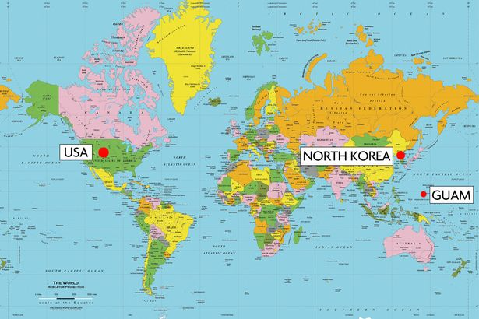
MAPS OF KOREA

Slide 18
Cold War in Asia: Korean War
Similar to Germany, after World War II control of the Korean peninsula was divided between the Soviet Union and the United States along the (5) 38th parallel
The Soviet Union helped establish a communist controlled country in (6) North Korea and the United States helped establish a non-communist country in (7) South Korea_.
While neither side liked the agreement and wanted to reunite their country under one rule, in the years following World War II, a divided Korea became reality.
Then suddenly in June of 1950, North Korea, under the leadership of (8) Kim Il-sung crossed the 38th parallel and invaded South Korea. The goal was to unite Korea under communist rule.

Slide 19
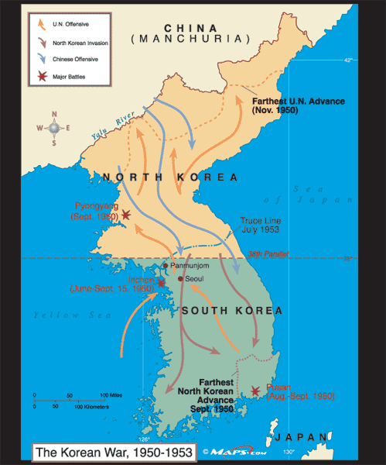
MAPS OF KOREA

Slide 20
Cold War in Asia: Korean War
The South Korean army was poorly trained and poorly equipped, and before the United States could blink, the North Korean army had taken nearly the entire country.
Faced with another communist defeat, Truman ordered (9) General Douglas MacArthur to push the communist back over the 38th parallel.
The United States, with the help of United Nation forces, quickly took back South Korea and even invaded North Korea. It seemed as if all of Korea would be freed from communism.
Then, in November of 1950, (10)China entered the war. Chinese troops pushed the United States and its allies all the way back across the 38th parallel.
Furthermore, the (11) U.S.S.R. was secretly providing planes and other supplies to the North Korean and Chinese forces.

Slide 21
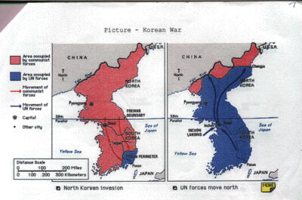
N. AND S. KOREAN ADVANCES

Slide 22
Cold War in Asia: Korean War
Finally, the United States was able to push the communists back to the 38th parallel.
General MacArthur was determined to defeat the North Koreans and Chinese even if it meant using nuclear weapons. However, Harry Truman wanted to follow his policy of containment and sign a peace deal that ended the fighting and kept Korea separated at the 38th parallel.
As MacArthur continued to publicly denounce Truman and challenge his authority, Truman was forced to fire MacArthur.
After three more years of brutal fighting, the Korean War ended with an (12)stalemate. Neither side admitted defeat and technically the two nations are still at war today.
However, for Truman, Korea was a victory, as communism had been contained.

Slide 23
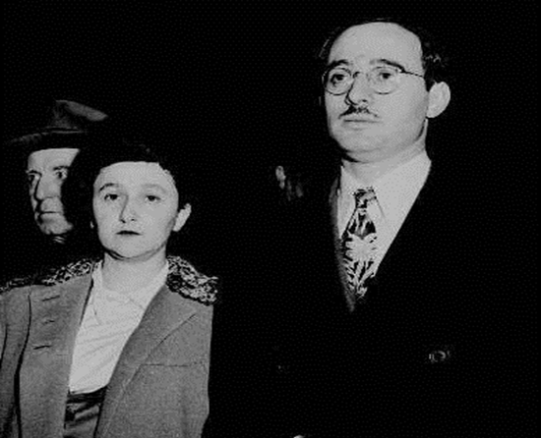
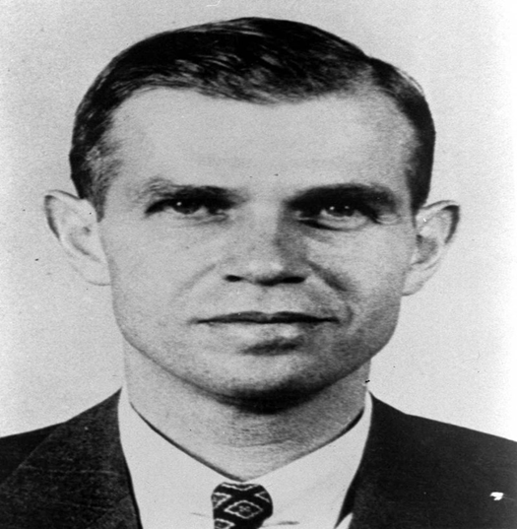
American in the Cold War: Second Red Scare
-When China fell to communism in 1949, fears or communism spreading in the US elevated.
-Convicted spies Alger Hiss Julius & Ethel Rosenberg (sold atomic bomb secrets to USSR) heightened fears
-The House Un American Activities Committee began investigated government workers and targeted Hollywood

Slide 24
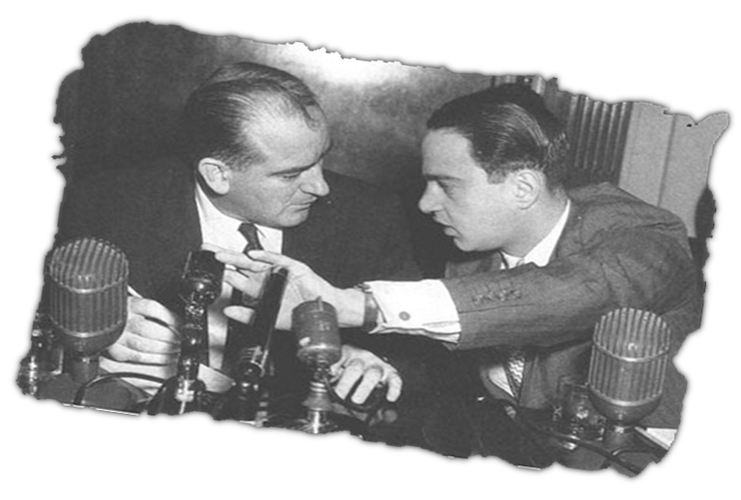
American in the Cold War: McCarthyism
-Attempted to uncover communist spies turned into a witch hunt with Senator Joseph McCarthy who accused people of being communist with no evidence. He wanted to gain political power.
-Hysteria turned against him when he investigated the Army (on TV) with not proof. McCarthyism ended.

Slide 25
Harry Truman’s Domestic Policies
GI Bill Of Rights: veterans tax supported college education or vocational training and low-interest home loans. Supported
Truman desegregated the military. Controversial . Beginning of the Civil Rights movement.
1948, Truman attempted to continue the New Deal with the Fair Deal:
Created jobs government projects
Extend Social Security benefits
Raised the minimum wage
Tried to end job discrimination against African-Americans
Since G Depression was over the Fair Deal was not as popular as the New Deal.

Slide 26
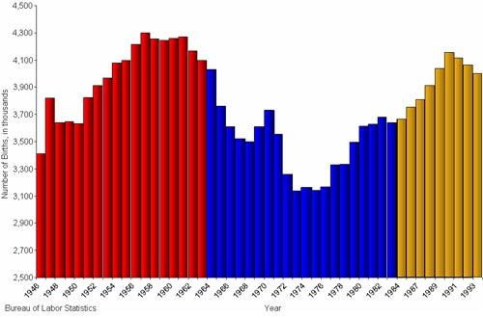
BABY BOOMER CHART

Slide 27
Dwight Eisenhower: Domestic Policies
Baby Boom -1950’s US birth increase with returning soldiers began starting families after World War II.
Economy surged 1950’s; strongest in the world.
Automania- Car changed US landscape.
Suburbs- Grew as people with money purchased cars and moved out of the city.
de facto segregation-took place as as many white middle class workers moved out of cities to the suburbs.
Automania also led Eisenhower and Congress passing Interstate Highway Act (built interstates across US & provided jobs)

Slide 28
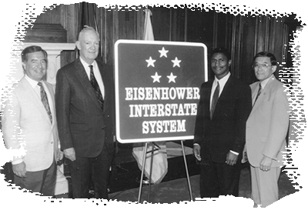

Slide 29
Pop Culture in the 1950’s
The 1950s started Mass Media - communication to reach large audiences. (TV 90% of people had one by 1950s). Early TV showed only ideal white US family; no problems; no minorities. The Federal Communications Commission censored inappropriate /un-American TV.
Women must be wives/mothers. Not work outside of the home.
Beatnik- Artist challenged this push for normal American life.
Rock & Roll-Started in the 1950’s and appealed to the younger generation. This music challenged the norms of society.

Slide 30
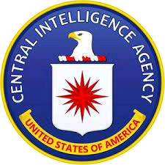
1950’s Cold War: CIA
1947 U.S. created Central Intelligence Agency- spy agency used to gather information on the communist threat worldwide.
Attempted to turn communist nations back to pro-U.S. regimes.
Created by Truman, Dwight Eisenhower was the first US President to use the CIA in attempts to over through governments in Iran, Guatemala, and Cuba. First two successful; last one failed. All led to resentment

Slide 31
Dwight Eisenhower’s Cold War Policies
Brinkmanship sing the full threat war to deter others. Ike used a strong military as a deterrence to Soviet communist aggression across the globe.
Led to space race as the Soviet Union raced to their arsenal so they could keep up with the United States.
“Domino Theory”-Ike’s Cold War policies/belief that if one country was allowed to fall to communist, then others would follow.
Ike was quick to contain communism wherever it arose. One place was communist aggression increased was the Middle East.
Eisenhower’s determination led to the Eisenhower Doctrine which pledged US support to any country fighting communist in the Middle East.

Slide 32
Cold War: Space Race
In 1957, the Soviet Union launched the first satellite into space, Sputnik. This achievement surprised and embarrassed the U.S.; led to the Space Race
Determined to catch up to the Soviet Union’s space program, Eisenhower and John F. Kennedy called for the U.S. education system to focus on math and science.
1958, Eisenhower signed the law to create National Aeronautics and Space Act, creating NASA
Kennedy supported space program promised a man on the moon before the end of the 1960’s.
Sure enough, American won the space race in 1969 when Neil Armstrong landed on the moon.

Slide 33
Cold War: U-2 Incident
At the end of his presidency, Eisenhower became embroiled in a Cold War scandal.
In 1960, Francis Gary Powers was flying a U-2 Spy Plane over the Soviet Union taking pictures for U.S. intelligence.
As he was flying his mission, his plane was shot down and Francis Gary Powers was arrested by the Soviet Union.
At first the Eisenhower tried to deny that Powers was spying, but eventually the truth came out and made the United States look bad.
The U-2 Incident contributed to raising tensions between the United States and the Soviet Union.
However, in 1962, the United States and the Soviet Union initiated a prisoner swap, and Francis Gary Powers was released.

Slide 34
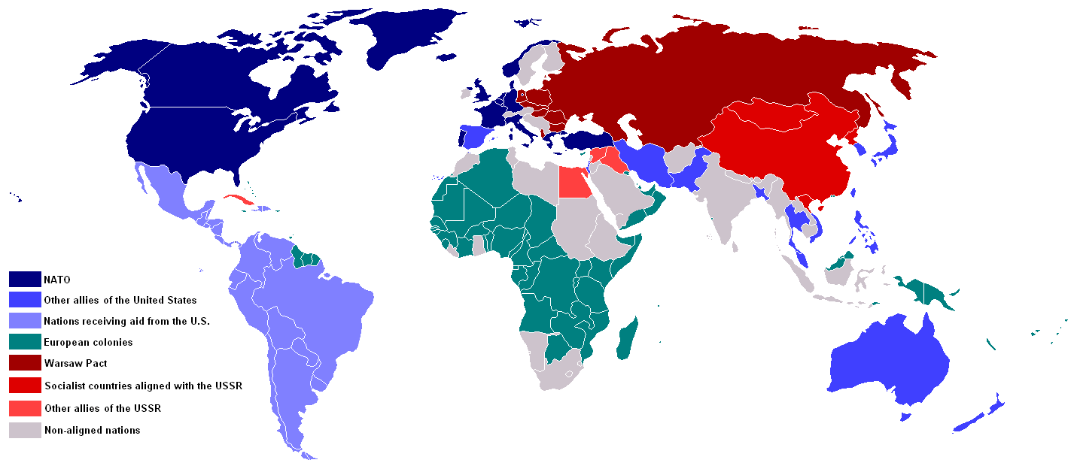
COLD WAR MAP IN 1959

Slide 35
Kennedy (JFK) and the Cold War
After two terms with Eisenhower, US elected John F. Kennedy, a World War II veteran and the youngest president
Kennedy’s approach to the Cold War was different than Eisenhower’s. Eisenhower used brinkmanship (threat of all out war), Kennedy used Flexible Response – a variety of military/political options (CIA, negotiations, financial aid, etc…) instead war.
United States & Cuba
After the Spanish-American War the US did not allow Cuba full independence
1959- Cuban revolutionary Fidel Castro ousted the US backed government and put in place a a Soviet Union communist one.
U.S. was embarrassing and scared as Cuba is 90 miles from Florida.

Slide 36
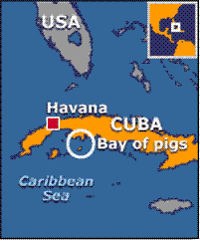
Kennedy (JFK): Bay of Pigs Invasion
Kennedy wanted to kick out Castro and restore a US backed Cuban government using Flexible Response.
First the CIA tried to kill Castro but that did no work.
Then the CIA tried to overthrow the communist government.
Bay of Pigs Invasion 1961-The U.S. supported Cuban rebels to invade and overthrow Fidel Castro, but he Castro found out and killed the Cuban rebels. U.S. Embarrassment; increased tensions

Slide 37
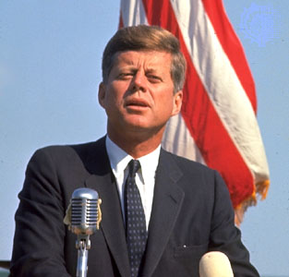
CUBAN MISSILE CRISIS! THE MEN INVOLVED: Kennedy Castro Khrushchev

Slide 38
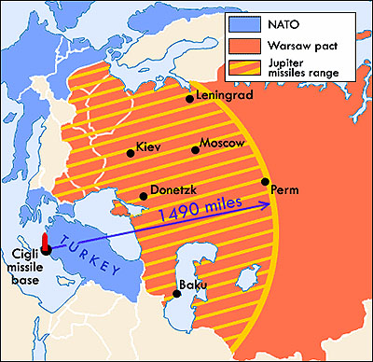
Kennedy (JFK): Cuban Missile Crisis
Cuban Missile Crisis 1962-U.S. placed missiles in Turkey toward Soviet Union, and they placed nuclear armed missiles in Cuba toward the U.S.
US & USSR as close as they ever would to using nuclear weapons and blowing each other up.
Neither Kennedy or Khrushchev (the leader of the Soviet Union) wanted to use the weapons, but neither side could back down.

Slide 39
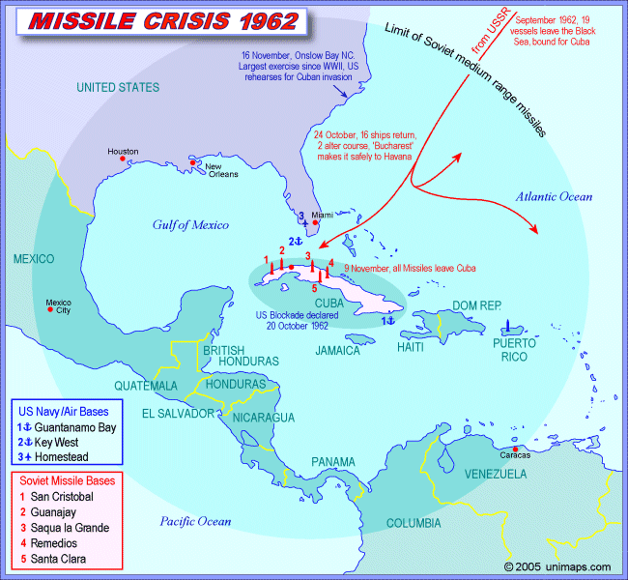
THE CUBAN MISSILE CRISIS!

Slide 40
Kennedy (JFK): Cuban Missile Crisis
Ultimately, Kennedy placed a quarantine Cuba to prevent Soviet weapons from.
Fortunately, Kennedy and Khrushchev negotiated a deal:
The United States would remove their missiles from Turkey and the Soviet Union would remove their missiles from Cuba.
The United States would stop trying to replace Fidel Castro.
They negotiated the Nuclear Test Band Treaty which prevented the testing nuclear bombs in the atmosphere.
They established the Hot Line to connect the president of the United States with the leader of the Soviet Union in case of another incident like the Cuban Missile Crisis.

Slide 41
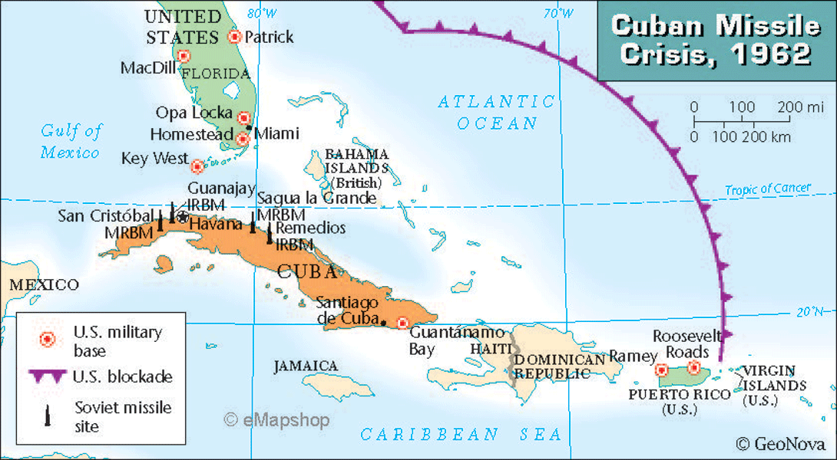
Kennedy (JFK): Cuban Missile Crisis

Slide 42
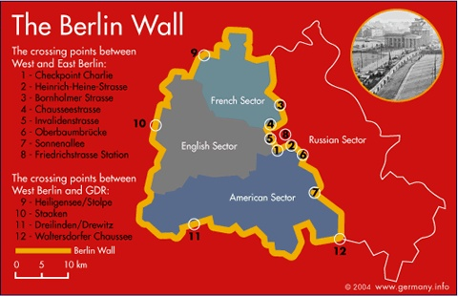
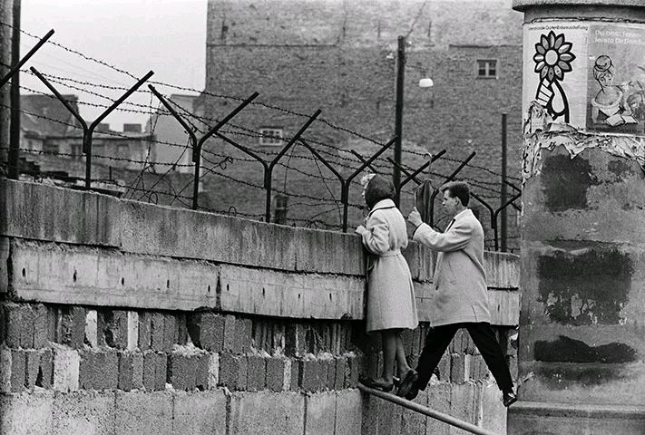
Kennedy (JFK):Berlin Wall
The conflict between democracy and communism remained.
Berlin Wall In Europe East Berliners (Communist) were escaping to democratic West Berlin embarrassing the U.S.S.R..
1961- Khrushchev ordered the building of the Berlin Wall to keep East Berliners from fleeing
The Berlin Wall was a (concrete) symbol for the divide between communism and democracy.

Slide 43
